Slide 1
Everything You Always Wanted to Know About E-Books
Barbara Fiehn Ed. D.
Western KY University
Bowling Green , KY

Slide 2
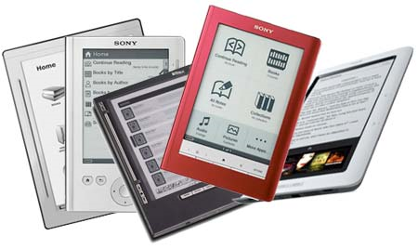
How many of you
Read Books
Devour Books
Listen to audio books
Read any kind of E-book

Slide 3
It isn’t either / or
“The human brain doesn’t change in one generation,” says Mr. Powers, author of the forthcoming Hamlet’s BlackBerry: A Practical Philosophy for Building a Good Life in the Digital Age. “It’s not going to happen like that.”

Slide 4
“The technology of the book has withstood 500 years for a reason. It’s a superior, time-tested object.
I can envision a future where everyone has a Kindle. But I don’t think that means the eradication of books.”
Dennis Loy Johnson, the publisher of Melville House, a Brooklyn-based press.

Slide 5
The technology of “the book” has already seen a number of transitions in its long history: from clay to wax to papyrus to vellum to cloth to paper, stored as tablets or scrolls or folios or books, bound in horn or leather or cloth or paper
Doug Johnson School Library Journal November 2004, Turning the Page (E-books and their impact on libraries) http://www.doug-johnson.com/dougwri/turning-the-page-e-books.html

Slide 6
Digital Book History
1971 Michael Hart (Gutenberg Project) initiated digitized text: Declaration of Independence.
1981 the first electronic book with commercial aims : a dictionary by Random House
1998 the first e-Book Fair took place in Gaithersburg, Maryland
2001 e-book boom started with Riding the Bullet, by Stephen King, launched on the Internet

Slide 7
Does it matter
Ebook
E-book

Slide 8
Defining E-Book
Electronic book
  a book published in electronic form
  Inclusive: digital format – text and perhaps graphics
  Excludes: audio books (yes or no)

Slide 9
Outline
What – forms and formats
  Appliances
  Book formats
  From Whom
Issues
  Rewiring
  Skim and Scan vs Deep reading
  Eye strain
Purchasing

Slide 10
My Words of Wisdom
Change will continue
Formats are not yet settled
Go for most flexibility
Understand your needs / purpose
This is not a fad

Slide 11
Appliances
Computer
Cell Phone (web enabled)
Dedicated Appliance
  cannot be transferred to another appliance
  Rocket and SoftBook, Kindle, Nook
Open, Multipurpose Appliance
  Open eBook Publication Structure
CD / DVD / Blue Ray?
Costs - $130 >

Slide 12
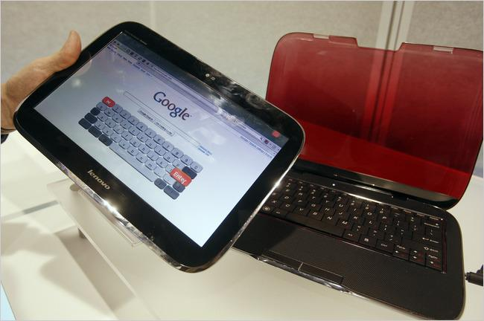
Lenovo's hybrid PC that detaches to become a tablet netbook device.

Slide 13
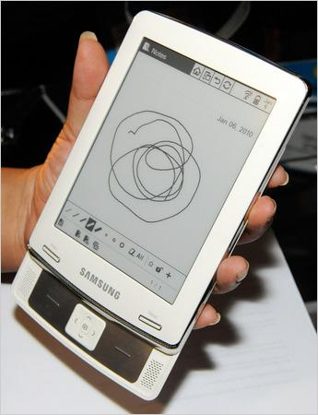
The new E6 electronic reader from Samsung.

Slide 14
C.E.S. 2010: Explosion of E-Book Readers
Brad Stone on the proliferation of e-book readers at this year's Consumer Electronics Show. http://video.nytimes.com/video/2010/01/08/technology/personaltech/1247466451590/c-e-s-2010-explosion-of-e-book-readers.html?scp=1&sq=C.E.S.%202010:%20Explosion%20of%20E-Book%20Readers&st=cse
Comments on the I-Pad http://video.nytimes.com/video/playlist/technology/1194811622271/index.html#1247466754459

Slide 15











e-book device or e-reader

Slide 16

Nook

Slide 17
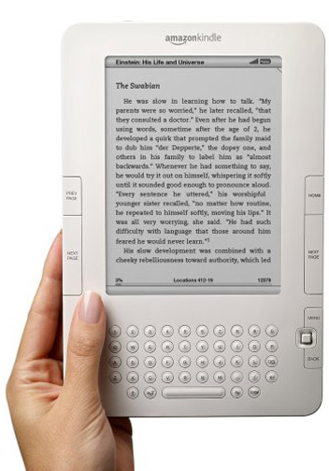
Kindles

Slide 18
Kindle/Nook for PC
Kindle download http://www.amazon.com/gp/feature.html?ie=UTF8&ref_=ms_sbrspot_0&docId=1000426311
Nook download http://www.barnesandnoble.com/ebooks/download-reader.asp?dltab=pc
Free books

Slide 19
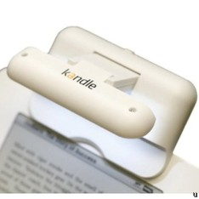
The Kandle ebook light
compatible with any
eBook reader
dual pivoting arms allow it to fold up to a slightly more compact form
the light from the 2 LEDs can be directed as needed.

Slide 20
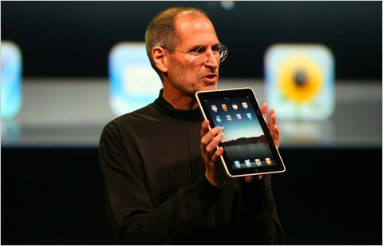

Slide 21
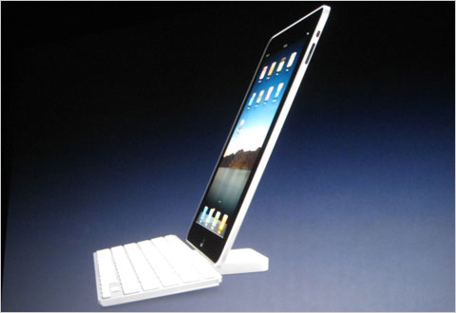

Slide 22
vook
Browser based or mobile app
Four views:
  traditional format while integrating logical video breaks.
  watch view plays high-quality, full screen videos that bring the words and story to life. You can read along with the text in a pull down window.
  The mix view combines both the text and video on one screen.
  connect view engages the reader with related conversations on the social Web.

Slide 23
Blio
free eReader
Any device or reader
ability to highlight and annotate text, hear the text read aloud, and support embedded multimedia such as video and audio.
up to five devices per user

Slide 24
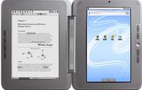
eDGe has an e-reader screen on the left and an LCD screen on the right for color displays.
Current target is Textbooks

Slide 25


Cell phone apps for kids

Slide 26
Don’t forget your MP3 player or the Ipod Touch.
  Downloadable apps for both B&N and Amazon
  Multiple uses

Slide 27
Your ebook appliance
Like MOST
Like LEAST

Slide 28
Reasons
Always with you
Out of print texts
  Replica Books and Ingram's Lightning Source, store fully marked-up digital text or scanned page images on demand, one at a time.

Slide 29
Reasons
Reading
  Fluency
  Hypertext supports clarity
  Language Acquisition

Slide 30
What to consider
Costs
Appliances
  Durability
  Longevity
  Single function vs multi function
  What is already in student hands
  Battery life
  Resolution in dpi
  Storage capacity
  Collections
    Contracts
      Own
      Lease
    Multiple downloads
      Single copies
      Collections

Slide 31
Ebook Text Formats
EPUB -a free open standard supported by a range of reading devices, allows readers to move their digital books across platforms
DRM – Digital Rights Management
PDF – Portable Document Format
Mobipocket format (.prc),
mobipocket palm (.pdb)
Amazon (AZW)
microsoft word (.doc), plain text (.txt),
web browser (.html), microsoft reader (.lit),
sony reader (.lrf), sony librie (.lrf),, rocket (.rb),
hiebook (.kml), plucker (.prc), Isilo (.pdb), f
ictionbook (.fb2), psion (.tcr)

Slide 32
Low vision capabilities
Required by law.
Frequently ignored by vendors

Slide 33
Eye Strain Myth
Dr. Travis Meredith, University of North Carolina, Chapel Hill, chair ophthalmology department
“The current problem with reading on screens is that we need to adjust our bodies to our computer screens, rather than the screens adjusting to us,”

Slide 34
“While you’re reading, your eyes make about 10,000 movements an hour. It’s important to take a step back every 20 minutes and let your eyes rest,”
Professor Alan Hedge, director of the Human Factors and Ergonomics Laboratory at Cornell University

Slide 35
Vendors - Children
BookFliks
Sylvan/Dell
NetLibrary
Abdo
Pebble
TumbleBooks
Starfall – free
Apple App store -Just Me and My Dad
Raz Kids
Moving Picture Books
Sesame Street e-book content-www.sesamestreet.org/ebooks
iStoryTime, an e-book platform for iPhone and Android OS

Slide 36
Vendors - General
I Save A Tree, Inc. Bilingual
netLibrary - allows unlimited access to titles
Overdrive - 3 items for one week
audible.com
Follett and other book vendors
Gale
Escue & Associates www.escuebooks.com
Davidson

Slide 37
Vendors - Periodicals
EBSCOhost mobile

Slide 38
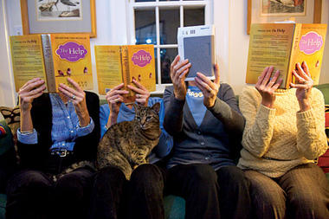
13 percent of American adults who’ve purchased at least one book in the past year own an e-reader, or plan to own one within the next year.

Slide 39
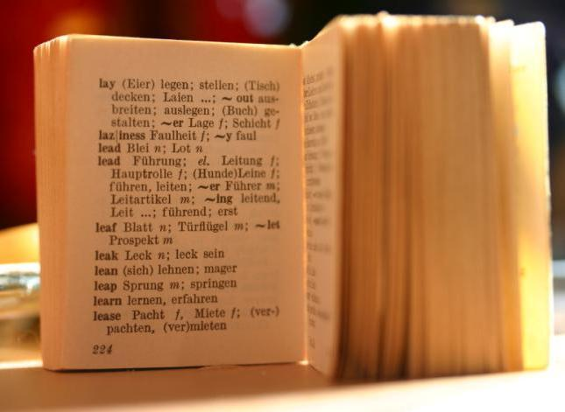
Is there really something mystical about printing a book on pulped paper?

Slide 40
Possibilities
Ebook clubs – readers miles apart instantaneously sharing notations
Home subscriptions -services based on interest
Disney, $79.95 a year to tap a treasure-trove of digitized storybooks, full of videos, music, and point-and-click games.
Reading resembles a social-networking environment with instant interact with the publisher, the author, and the text itself.

Slide 41
Nice to Know
EduKindle Kindle for Educators

Slide 61
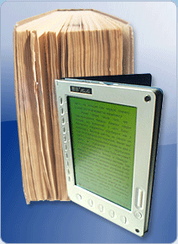

Slide 62


Slide 63
http://people.wku.edu/barbara.fiehn/

