Slide 1
Amost Everything You Always Wanted to Know About E-Books
Barbara Fiehn Ed. D.
Western KY University
Bowling Green , KY

Slide 2
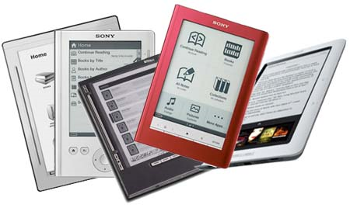
How many of you
Read Books
Devour Books
Listen to audio books
Read any kind of E-book

Slide 3
My Words of Wisdom
Change will continue
Formats are not yet settled
Go for the most flexibility
Understand your needs / purpose
This is not a fad

Slide 4
Digital Book History
1971 Michael Hart (Gutenberg Project) initiated digitized text: Declaration of Independence.
1981 the first electronic book with commercial aims : a dictionary by Random House
1998 the first e-Book Fair took place in Gaithersburg, Maryland
2001 e-book boom started with Riding the Bullet, by Stephen King, launched on the Internet

Slide 5
It isn’t either / or
“The human brain doesn’t change in one generation,” says Mr. Powers, author of the forthcoming Hamlet’s BlackBerry: A Practical Philosophy for Building a Good Life in the Digital Age. “It’s not going to happen like that.”

Slide 6
The technology of “the book” has already seen a number of transitions in its long history: from clay to wax to papyrus to vellum to cloth to paper, stored as tablets or scrolls or folios or books, bound in horn or leather or cloth or paper
Doug Johnson School Library Journal November 2004, Turning the Page (E-books and their impact on libraries) http://www.doug-johnson.com/dougwri/turning-the-page-e-books.html

Slide 7
Defining Ebook
Electronic book
  a book published in electronic form
      Text
      Graphics
      Sound
  Interactivity

Slide 8
Ebooks Available As
Online Free/subscription
  Used online
  Downloadable
Self contained
  Playaway
  CD/DVD
  Network Server
Audio
Text
Text and audio
Interactive
Multi language

Slide 9
Appliances
Computer
Cell “Smart” Phone
IPod touch, IPad
MP3 players
Dedicated Appliance
  Kindle, Nook, Vook, Microsoft Reader
Open, Multipurpose Appliance
  Open eBook Publication Structure
CD / DVD / Blue Ray?

Slide 10
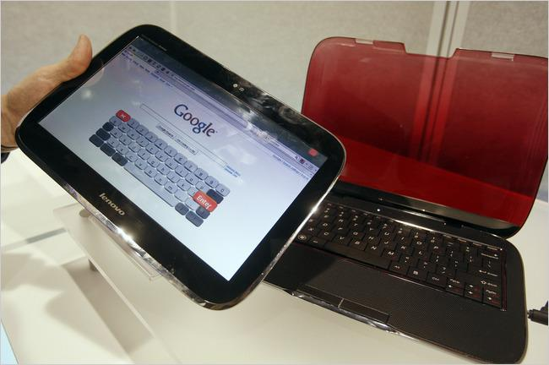
Lenovo's hybrid PC that detaches to become a tablet netbook device.

Slide 11
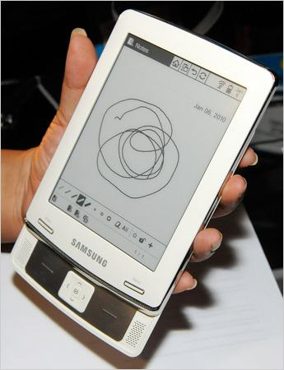
E6 electronic reader from Samsung.

Slide 12











e-book device or e-reader

Slide 13


Cell phone apps for kids

Slide 14
Reasons
Always with you
Out of print texts
  Replica Books and Ingram's Lightning Source, store fully marked-up digital text or scanned page images on demand, one at a time.

Slide 15
Reasons
Reading
  Fluency
  Hypertext supports clarity
  Language Acquisition
Some prefer digital formats

Slide 16
What to consider
Costs
Appliances
  Durability
  Longevity
  Single function vs multi function
  What is already in student hands
  Battery life
  Resolution in dpi
  Storage capacity
  Collections
    Contracts
      Own
      Lease
    Multiple downloads
      Single copies
      Collections
    Policies and procedures

Slide 17
Ebook Text Formats
EPUB -a free open standard supported by a range of reading devices, allows readers to move their digital books across platforms
DRM – Digital Rights Management
PDF – Portable Document Format
Mobipocket format (.prc),
mobipocket palm (.pdb)
Amazon (AZW)
microsoft word (.doc), plain text (.txt),
web browser (.html), microsoft reader (.lit),
sony reader (.lrf), sony librie (.lrf),, rocket (.rb),
hiebook (.kml), plucker (.prc), Isilo (.pdb), f
ictionbook (.fb2), psion (.tcr)

Slide 18
Low vision capabilities
Required by law.
Frequently ignored by vendors

Slide 19
Eye Strain Myth
Dr. Travis Meredith, University of North Carolina, Chapel Hill, chair ophthalmology department
“The current problem with reading on screens is that we need to adjust our bodies to our computer screens, rather than the screens adjusting to us,”

Slide 20
“While you’re reading, your eyes make about 10,000 movements an hour. It’s important to take a step back every 20 minutes and let your eyes rest,”
Professor Alan Hedge, director of the Human Factors and Ergonomics Laboratory at Cornell University

Slide 21
Other issues
Battery Life
Unwanted downloading
Damage, loss

Slide 22
Vendors - Children
BookFliks
Sylvan/Dell
NetLibrary
Abdo
Pebble
TumbleBooks
Starfall – free
Capstone
Apple App store -Just Me and My Dad
Raz Kids
Moving Picture Books
Sesame Street e-book content-www.sesamestreet.org/ebooks
iStoryTime, an e-book platform for iPhone and Android OS

Slide 23
Vendors - General
I Save A Tree, Inc. Bilingual
netLibrary - allows unlimited access to titles
Overdrive - 3 items for one week
audible.com
Follett and other book vendors
Gale
Escue & Associates www.escuebooks.com
Davidson
Many online vendors

Slide 24
Vendors - Periodicals
EBSCOhost mobile

Slide 25
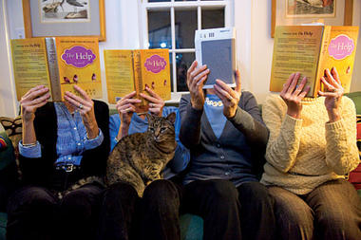
13 percent of American adults who’ve purchased at least one book in the past year own an e-reader, or plan to own one within the next year.

Slide 26
Possibilities
Ebook clubs – readers miles apart instantaneously sharing notations
Home subscriptions -services based on interest
Disney, $79.95 a year to tap a treasure-trove of digitized storybooks, full of videos, music, and point-and-click games.
Reading resembles a social-networking environment with instant interact with the publisher, the author, and the text itself.

Slide 27
Kindle for Educators
http://www.edukindle.com/

Slide 28
Website
http://people.wku.edu/barbara.
fiehn/Ebooks/EBooks.html
Barbara Fiehn Ed. D.
Western KY University
Bowling Green , KY

