Slide 1
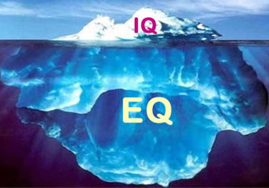
Emotional Intelligence
Ashley Bartholomew
Cory Burton
Ashley Dickens-York

Slide 2
Overview of Emotional Intelligence
Brief History
EI Models/Measurement
Ability Based Model
Trait EI Model
Mixed Models
Problems/Criticisms of EI
EI in the Workplace

Slide 3
Origins of the Concept
Darwin’s early work on the importance of emotional expression for survival (1870s)
E.L. Thorndike (1920) used the term social intelligence to describe the skill of understanding and managing other people
**

Slide 4
Origins of the Concept
David Wechsler (1940) described the influence of non-intellectual factors on intelligent behavior
Argued that models of intelligence won’t be complete until they adequately describe these factors
**

Slide 5
Origins of the Concept
Howard Gardner (1983) introduced the ideal of multiple intelligences
Interpersonal intelligence: the capacity to understand the intentions, motivations, and desires of other people
Intrapersonal intelligence: the capacity to understand oneself, to appreciate one’s feelings, fears, and motivations
**
Notes:
Gardner’s View: traditional types of intelligence, such as IQ, fail to fully explain cognitive ability

Slide 6
Origins of the Concept
The term “Emotional Intelligence” finally became widely popular upon the publication of Daniel Goleman’s best seller
Emotional Intelligence: Why It Can Matter More Than IQ
**

Slide 7
Emotional Intelligence Models
Much confusion regarding exact meaning of this construct
Defined slightly differently by each model
3 main models of EI:
Ability EI Models
Trait EI Model
Mixed Models of EI

Slide 8
Ability Based EI
Developed by Peter Salovey and John D. Mayer
Define EI: “the ability to perceive emotion, integrate emotion to facilitate thought, understand emotions, and to regulate emotions to promote personal growth”
**

Slide 9
Ability Based EI: Assumptions
Emotional intelligence defined within the confines of the standard criteria for a new intelligence
Emotions are useful sources of info that help one to make sense of/navigate their social environments
**

Slide 10
Ability Based EI: Assumptions
Individuals vary:
In their ability to process information of an emotional nature
In their ability to relate emotional processing to a wider cognition
These abilities manifest in certain adaptive behaviors
**

Slide 11
Ability Based EI: Assumptions
Emotional Intelligence Abilities:
Perceiving Emotions - ability to decipher emotions in faces, pictures, voices, and cultural artifacts
Understanding Emotions - ability to comprehend emotion language and to appreciate complicated relationships among emotions
**

Slide 12
Ability Based EI: Assumptions
Emotional Intelligence Abilities:
Using Emotions - ability to harness emotions to facilitate various cognitive activities, such as thinking and problem solving
Managing Emotions - ability to regulate emotions in both ourselves and in others
**

Slide 13
Ability Based EI: Measurement
MSCEIT: Mayer-Salovey-Caruso Emotional Intelligence Test
Based on a series of emotion-based problem-solving items
Tests individual’s abilities on each of the four branches of emotional intelligence
Scores generated for each of the four branches as well as a total score
**

Slide 14
Ability Based EI: Measurement
MSCEIT: Scoring
Individual’s responses compared to those provided by worldwide sample of respondents
With higher scores indicating higher overlap between individual and comparison group
Expert-scored
Where individual’s score is compared to a group of 21 emotion researchers
Unlike IQ test, items on MSCEIT do not have objectively correct responses
Difficult to regard as a genuine intelligence

Slide 15
Ability Based EI: Measurement Issues
MSCEIT may only measure knowledge, not ability: That is, even though someone may know how to behave in an emotional situation, he/she may not be able to carry out behavior (Brody, 2004)
MSCEIT may only measure conformity
(Roberts et al., 2001)
Self-report measures are susceptible to social desirability bias

Slide 16
Trait EI Model
Proposed by Petrides et. al. (2000)
Major critics of ability based model and MSCEIT
Defined Trait EI: “a constellation of emotion-related self-perceptions located at the lower levels of personality”
Based on individual’s self-perceptions of their emotional abilities
**

Slide 17
Trait EI: Measurement
TEIQue: Trait Emotional Intelligence Questionnaire
Self-report inventory
15 subscales organized under 4 factors:
Well-being
Self-control
Emotionality
Sociability
Along with scores for the subscales and main factors, a global trait EI score is also given
**
Notes:
Long Form = 153 items
Short Form = 30 items

Slide 18
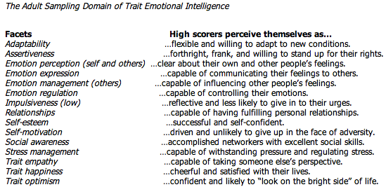
Trait EI: TEIQue Measurement

Slide 19
Trait EI: Findings
TEIQue:
Scores have been found to be globally normally distributed and reliable
Scores were not related to nonverbal reasoning
Possible support for the personality trait view
Related to Big 5:
Positively related – Extraversion, Agreeableness, Openness, Conscientiousness
Inversely related – Neuroticism
**

Slide 20
Mixed Models of EI: Emotional Competencies
Developed by Daniel Goleman
Define EI: “a wide array of competencies and skills that drive leadership performance”
People are born with general emotional intelligence that determines their potential for learning emotional competencies
These competencies are learned capabilities that must be worked on to achieve outstanding performance
**

Slide 21
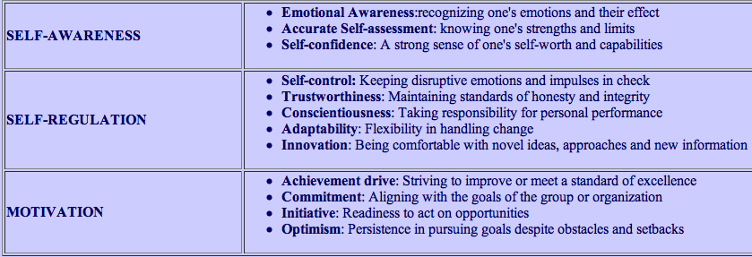
Mixed Models of EI: Emotional Competencies
Personal Competence

Slide 22
Mixed Models of EI: Emotional Competencies
Social Competence
Notes:
Goleman’s model has been criticized in the research literature as mere pop-psychology

Slide 23
Emotional Competencies: Measurement
Two measurement tools for Goleman’s model
ECI: Emotional Competency Inventory, 1999
Revised; ESCI: Emotional and Social Competency Inventory, 2007
Emotional Intelligence Appraisal, 2001
Can be self-report
Or 360-degree assessment
**

Slide 24
Emotional Competencies: Measurement
ECI – Emotional Competence Inventory
Approximately 40% of items came from an older instrument, the Self-Assessment Questionnaire
Developed by Boyatzis, 1994
These earlier items have been validated against performance in hundreds of competency studies of managers, executives, and leaders in North America, Italy, and Brazil
There is no research that supports the validity of ECI

Slide 25
Mixed Models of EI: Bar-On Model of Emotional-Social Intelligence
Developed by Reuven Bar-On
1st to use the term: Emotion Quotient
Define EI: “being concerned with effectively understanding oneself and others, relating well to people, and adapting to and coping with the immediate surroundings to be more successful in dealing with environmental demands”
**

Slide 26
Bar-On EI Model: Assumptions
Emotional intelligence develops over time
Can be improved through training or therapy
Emotional intelligence and cognitive intelligence contribute equally to a person’s general intelligence, which then indicates one’s potential to succeed in life
Individuals with higher than average EQ’s are in general more successful in meeting environmental demands and pressures
Deficiency in EQ can mean a lack of success and emotional problems
**

Slide 27
Bar-On EI Model: Factors

Slide 28
Bar-On Model: Factors

Slide 29
Bar-On Model: Measurement
EQ-I: Bar-On Emotion Quotient Inventory
133 questions used to obtain a Total EQ
Also gives 5 composite scale scores corresponding to the 5 main components of the model
Not meant to measure personality traits or cognitive capacity; rather the mental ability to be successful in dealing with environmental demands and pressures
Notes:
Problems: self-report…highly susceptible to faking

Slide 30
Bar-On Model: Measurement Issues
EQ-I
Self-report, highly susceptible to faking
Originally developed in a clinical setting, not the work environment
Much is known about its reliability and convergent and discriminate validity
Little is known about its predictive ability in the work environment
However, EQ-I was predictive of success for U.S. Air Force recruiters; by using the test, the Air Force saved 3 million dollars annually
Notes:
NOTEWORTHY: there were no racial or ethnic differences

Slide 31
Is EI a Form of Intelligence?
“Goleman exemplifies more clearly than most the fundamental absurdity of the tendency to class almost any type of behavior as an ‘intelligence’…If these five ‘abilities’ define ‘emotional intelligence’, we would expect some evidence that they are highly correlated; Goleman admits that they might be quite uncorrelated, and in any case if we cannot measure them, how do we know they are related? So the whole theory is built on quicksand: there is no sound scientific basis.”
Eysenck, 2000

Slide 32
Is EI a Form of Intelligence?
Locke (2005) suggested that emotional intelligence is not a new or distinct form of intelligence; rather, it is simply the intelligence construct applied to the domain of emotions. Hence, it is more like a skill.

Slide 33
Does EI Have Predictive Value?
Davies, Stankov, & Roberts (1998) concluded that there was nothing empirically new in the idea of emotional intelligence
Measures utilized at that time were new, and little was known about their psychometric properties (Cherniss, 2000)
Landy (2005) stated that the few incremental validity studies conducted on EI have shown that it adds nothing of real value to prediction of academic and work success

Slide 34
EI Measurement Issues
Business vs. Academics – the former often make grandiose predictions predicated upon emotional intelligence while the latter warns against unscientific abuses

Slide 35
EI Measurement Issues
For example: Goleman has asserted “the most effective leaders are alike in one crucial way: they all have a high degree of what has come to be known as emotional intelligence…EI is the sine qua non of leadership”
Mayer rebuts, “the popular literature’s implication-that highly emotionally intelligent people possess an unqualified advantage in life-appears overly enthusiastic at present and unsubstantiated by reasonable scientific standards”

Slide 36
EI and Gender Differences
Women are higher than men:
Empathy
Social Responsibility
Men are higher than women:
Stress Tolerance
Self Confidence

Slide 37
EI in the Workplace
Critics believe that improving literacy and analytical skills is the best way to improve job performance
Cognitive skills will only get you in the door
Steve Stein

Slide 38
EI in the Workplace
Highly Emotional Intelligent Employees:
Lower absenteeism
Better psychological health
Higher commitment
Clearer role boundaries
Higher job satisfaction
Better coping skills
Higher levels of responsibility and performance

Slide 39
EI in the Workplace
Importance of EI in bosses and leaders
CEO Information Vacuum
Tasler & Su
Measured EI of employees from janitors to CEOs

Slide 40
EI in the Workplace
Different jobs call for different EIQ
Sales associate
Tennis pro

Slide 41
Improving Company EI
Incorporate EI into hiring process
Develop interview questions to assess:
Self- awareness
Interpersonal skills
Stress management
Adaptability
Optimism
Level of happiness

Slide 42
Improving Company EI
Assess EI of current and possible future leaders
EQ-I
MSCEIT
ECI
Amend performance appraisals to include how the job gets done

Slide 43
Improving Company EI
Teaching EI
Work with psychologists and executive coaches
Stress management
Learn importance of listening, reading moods, and gaining trust

Slide 44
Thank You

Slide 45
References
Bielaszka-DuVernay, C. (2008). Hiring for Emotional Intelligence. Harvard Management Update. p. 3-5.
Cherniss, C. (2000). Emotional Intelligence: What it is and why it matters. Paper presented at the annual meeting of the Society for Industrial and Organizational Psychology.
Conrad, J. (2008). What’s Your Company’s EQ? Business West. p. 61.
Kimberly, J. (2008). How to fill the CEO information vaccum. New Hampshire Business Review. p. 27.
Mayer, J.D., Caruso, D.R., & Salovey, P. (2000). Emotional intelligence meets traditional standards for an intelligence. Intelligence 27(4), 267-298.

Slide 46
References
Murray, B. (1998). Does emotional intelligence matter in the workplace? APA Online. (29)7 p. 1-3.
http://www.eiconsortium.org/measures/teique.html
http://webhome.idirect.com/~kehamilt/ipsyeq.html
http://www.eiconsortium.org/measures/eqi.html
http://en.wikipedia.orgwikiEmotional_intelligence
http://www.indiana.edu/~intell/ethorndike.shtml

