Slide 1
Chapter 4
Restaurant Operations

Slide 2
RESTAURANT OPERATIONS
This module looks more closely at the actual operations of a restaurant
This module should reinforce the notion that to understand the restaurant business, one must not only study it but also work in it
Even though there are many different types of restaurants, much of the actual work that is performed in them is common across segments

Slide 3
RESTAURANT OPERATIONS
The typical restaurant can be divided into three general areas: (1) the front-of-the-house; (2) the back-of-the-house and; (3) the office
The front-of-the-house is where the customer is serviced; the back-of-the-house is where the food is produced/prepared and; the office is where much of the planning and management takes place

Slide 4
THE FRONT-OF-THE-HOUSE
The front-of-the-house is the part of the restaurants with which most of us are familiar because it is the most visible
It is where the customer and service staff come together—as a result it is referred to as the “marketplace” portion of the restaurant
It goes beyond this however; the front-of-the-house encompasses an operating system, a business place, and a social setting

Slide 5
THE FRONT-OF-THE-HOUSE
The primary responsibility of the front-of-the-house is assuring guest satisfaction
This comes down to several factors including:
    offering a quality product
    knowing what the guest wants
    having a properly planned service system
    having a properly trained staff
    empowering staff to make decisions
    taking care of problems when they arise

Slide 6
THE FRONT-OF-THE-HOUSE
Remember that errors will happen but what matters is how (and how quickly) they are corrected
Managers should also be present in the front-of-the-house, not just to supervise staff, but to assist them in performing their jobs, to monitor sales control, and to interact with guests
It is critical for all food service managers to have an understanding of the organization of the front-of-the-house

Slide 7
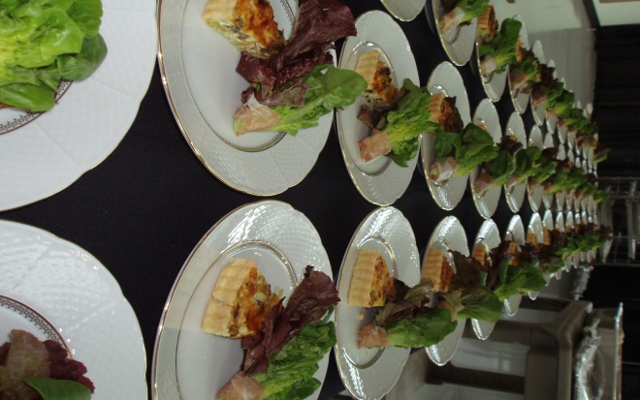
THE FRONT-OF-THE-HOUSE
FOH servers are also responsible for coordinating efforts with the BOH in placing accurate orders, picking them up in a timely manner and, in some cases, preparing some food and beverage products (salads, desserts and drinks)
Other responsibilities of FOH staff include maintaining control of sales including cash, checks and credit card sales
POS systems have simplified systems, provide greater control and have created a higher degree of efficiency

Slide 8
THE FRONT-OF-THE-HOUSE
Specific tasks include:
    Greeting the guest
    Taking the order
    Serving the food (and beverages)
    Checking with the table
    Removing used tableware
    Accepting payment
    Thanking the guest (last opportunity for internal promotion)

Slide 9
THE FRONT-OF-THE-HOUSE
Roles and positions for various FOH staff include:
    Hosts/Hostesses
    Counter person
    Servers
    Cashier
    Bussers

Slide 10
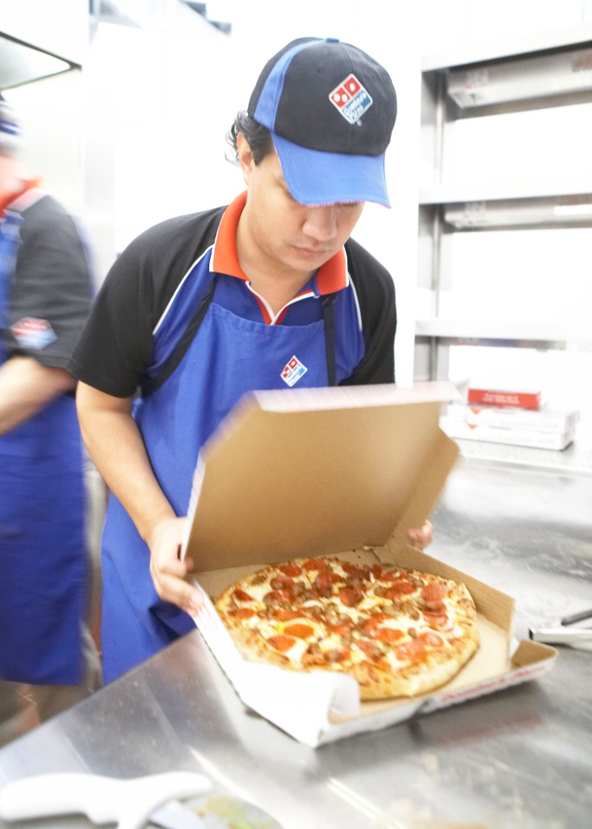
THE FRONT-OF-THE-HOUSE
Supervision entails the direct presence of management in the FOH. It is important for the employees and customers alike
Sometimes, depending on the company, supervision responsibilities are combined for the FOH and BOH

Slide 11
THE BACK-OF-THE-HOUSE
To take a production analogy, the back-of-the-house can be likened to a factory
Some restaurant kitchens prepare everything from scratch, some prepare a few items from scratch, and others simply assemble pre-prepared foods that may have been prepared several hundred miles away
The primary responsibility of the BOH is to prepare “quality” food

Slide 12
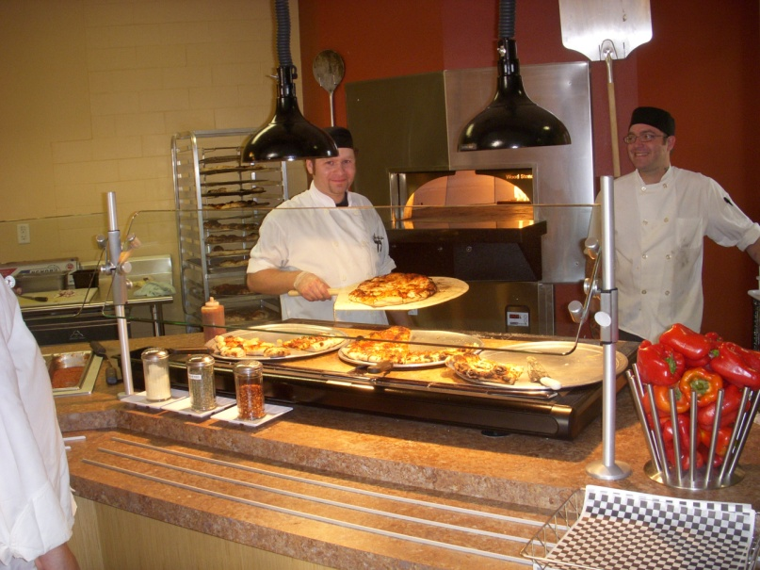
THE BACK-OF-THE-HOUSE
Various BOH tasks include:
    Purchasing and receiving
    Food “prep”
    Food production
    Portion control
    Quality control
    Safety and sanitation
    Dishwashing, etc.

Slide 13
MANAGEMENT
What is a manager?
What does a manager do?
Some thoughts:
  Someone who is “in charge”
  Someone who assigns tasks
  Someone who supports employees
  Someone who opens and closes the restaurant
  Someone who looks after the financial concerns

Slide 14
MANAGEMENT
Different operations use different titles
  General manager
  Unit manager
  Assistant manager
  Manager on duty
Responsibilities will differ as well
In all forms, there is a hierarchy

Slide 15
FINANCIAL CONSIDERATIONS
Making a profit can be a very challenging objective
The average restaurant makes about 4% on the dollar
Managers must be adept at increasing sales (revenue management) and controlling (or reducing) costs

Slide 16
FINANCIAL CONSIDERATIONS
Operating ratios used on a daily basis:
Expense ratios usually focus on variable costs:
  Food cost
  Beverage cost
  Labor cost
Sales/customer statistics commonly used include:
  Number of covers
  Average check

Slide 17
THE LIFE OF A MANAGER IN THE RESTAURANT INDUSTRY
Consider:
    Weekend, holiday and evening work
    Long work weeks
    Staying until the work is complete
    Salary levels (median in 2008 was just over $46,000)
    Wide range of responsibilities

