Slide 1
Beyond Showing Movies in Language Classes
Kentucky Foreign Language Conference 2011 — Technology
Nathan Love
(http://people.wku.edu/~nathan.love)
Western Kentucky University

Slide 2
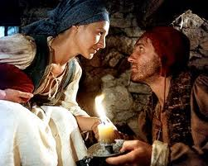
Beyond Showing Movies in Language Classes
Show video, film in 101-102 language classes?
Film = fun.
Vocabulary, comprehension, culture
Le retour de Martin Guerre

Slide 3
Beyond Showing Movies in Language Classes
The challenge:
To integrate video, film into the 101-102 language course
Syllabus
Food vocab.
La Blanquette de Veau

Slide 4
Beyond Showing Movies in Language Classes
During class meetings 10-20 minutes of a French movie
Showings overlap
Pauses are frequent
Pronunciation, vocab., questions over tu/vous, comprehension confirmed
How about integrating a feature-length film into a 101-102 course?

Slide 5
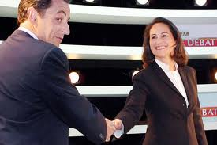
Beyond Showing Movies in Language Classes
Film can be exploited as an authentic linguistic document.
Greetings, polite chit-chat, good-byes
Nearly all film can reinforce and contextualize, in a sense, what we are doing in class.
Film becomes an important cultural document, as well.
How about integrating a feature-length film into a 101-102 course?

Slide 6
Beyond Showing Movies in Language Classes
How about integrating a feature-length film into a 101-102 course?
In watching a movie like Au revoir les enfants, I will make frequent pauses for questions and practice. "What family- related vocabulary did you hear?"
"Comment s'appelle le frère de Julien?”
A short segment may be repeated several times for comprehension pratice or pronunciation pratice.
Once the entire film viewed, scenes minus subtitles!
So much for viewing the film!

Slide 7
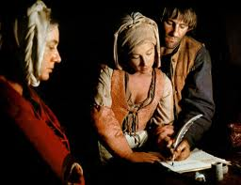
Beyond Showing Movies in Language Classes
How about integrating a feature-length film into a 101-102 course?
Film integrated into the course via assessments
Formative
Summative
Final exam!

Slide 8
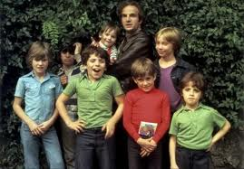
Beyond Showing Movies in Language Classes
How about integrating a feature-length film into a 101-102 course?
Film integrated into the course via assessments
(Other examples)
Student project ⧐

Slide 9
Beyond Showing Movies in Language Classes
FIN

Slide 10
Widescreen Test Pattern (16:9)
Aspect Ratio Test
(Should appear circular)
4x3
16x9

