Slide 1
Oracle Bones and Writing Stones
The Geography of Script
S. Kay Gandy
Western Kentucky University

Slide 2
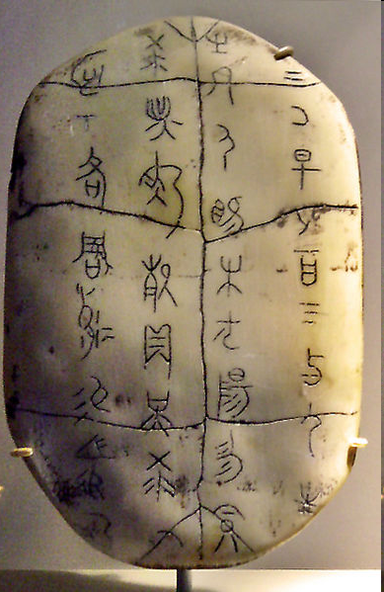
Oracle Bones
Turtle Plastrons and Cattle Shoulder Bones
4600 known characters
1600 B.C.
First written evidence that Shang culture existed
Used for Divination
Photo from Wikipedia

Slide 3
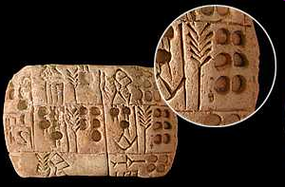
Writing Stones
Sumerian Cuneiform
Logograms and syllables
600 signs
95% related to economics
3100 B.C.
Photo from mesopotamia.com.uk

Slide 4
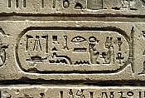
Writing Stones
Egyptian Hieroglyphs
Logographic and alphabetic elements
Over 5000 glyphs
3400 BC
http://www.kinderart.com/arthistory/egypt_bod.jpg

Slide 5
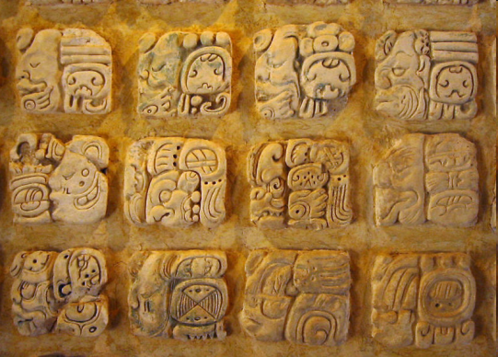
Writing Stones
Mayan Glyphs
Logosyllabic system
250 BC
Stelae
Photo from Wikipedia

Slide 6
Information in Script
Lunar cycles
Births
Marriages
Deaths
Battles
Festivals
Ceremonies
Prophecies
Geographic Phenomenon
Natural Disasters
Royal Lineage
Rituals
Customs/Traditions

Slide 7
Geography of Script
How the environment influenced writing materials and tools
How climate protected or destroyed writing materials
Spatial diffusion of writing
Regional influences on writing

Slide 8
Writing Materials and Tools
Determined by location and whatever was available
China: bamboo, silk, jade, wood, stones, bones, paper
Mesopotamia: clay readily available; easy to erase and preserve
Lower Egypt: papyrus plants
Quills from feathers; reed pen from reeds; stylus from iron, bronze, silver, ivory

Slide 9
Writing Materials and Tools
Have students speculate on that might not have survived through the centuries
Make conclusions about climate and writing
  Wet climate of China v. dry climate of Egypt
Make conclusions about formation of script
  German runes from knife cuts on sticks and bones
  Straight lines on palm leafs
Experiment with pigments and writing from materials in nature

Slide 10
Diffusion of Script
Roman Catholicism—Latin
Koran—Arabic Script
Greek Orthodoxy—Cyrillic Script
Printing and Computer Use—Latin

Slide 11
Diffusion Activities
Make conclusions about why parchment was never used in India or East Asia
  use of butchered animal skins to write sacred texts offended the religious beliefs of Hindus and Buddhists
Map the spread of Latin and Arabic Languages
Follow Trade Routes to determine the diffusion of script

Slide 12
Regional: Unity and Identity
First Emperor of Qin (221 B.C.)
  Standardized writing
  Connected varied ethnic groups
Sequoyah of the Cherokee
  No tribe had complete written language
  Preserve knowledge; provide documents

Slide 13
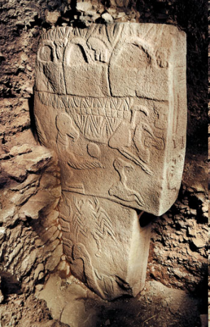

Newly Discovered
Neolithic site of Jiahu (Xueqin, Harbottle, Zhang, & Wang, 2003). There the plastrons were placed by the head, foot, or thigh of a deceased person and carried incised marks featuring 11 different signs. The authors concluded that these signs were “intentional and significant” and represent more than just a clan sign. These
Neolithic site of Jiahu (Xueqin, Harbottle, Zhang, & Wang, 2003). There the plastrons were placed by the head, foot, or thigh of a deceased person and carried incised marks featuring 11 different signs. The authors concluded that these signs were “intentional and significant” and represent more than just a clan sign. These
Neolithic site of Jiahu (Xueqin, Harbottle, Zhang, & Wang, 2003). There the plastrons were placed by the head, foot, or thigh of a deceased person and carried incised marks featuring 11 different signs. The authors concluded that these signs were “intentional and significant” and represent more than just a clan sign. These
Gobekli Tepe in Turkey
Neolithic Age
Neolithic site of Jiahu
Plastrons in graves bearing 11 signs
Photo from Smithsonian
Photo from Wikipedia
Notes:
9500 BCE Stone Age

