Slide 1
Amsterdam 2015
Orientation 1

Slide 2
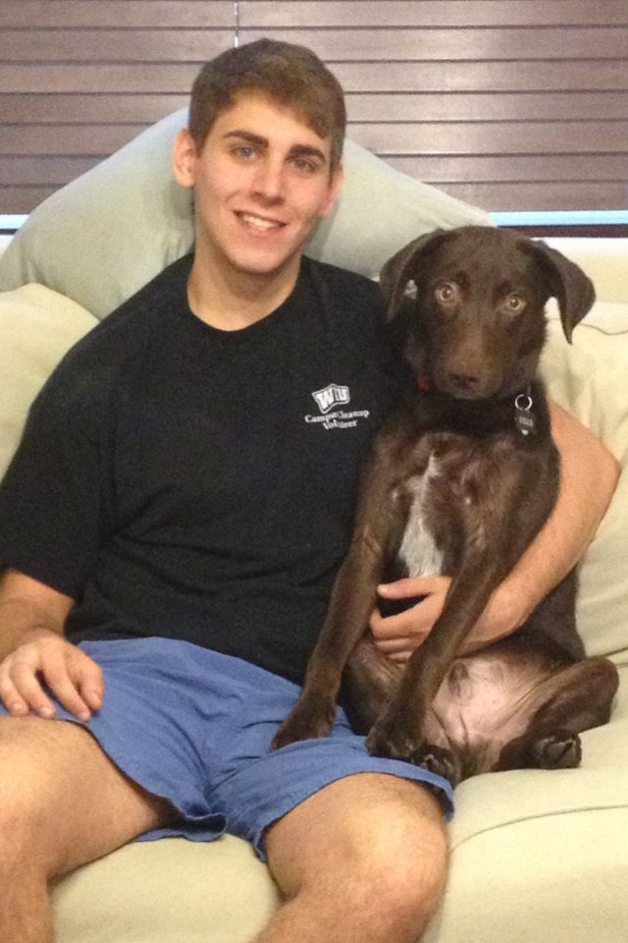
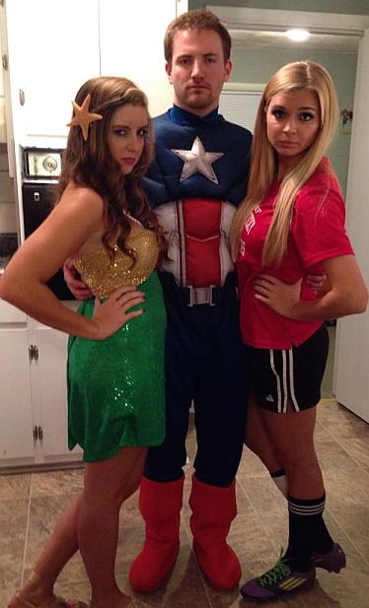
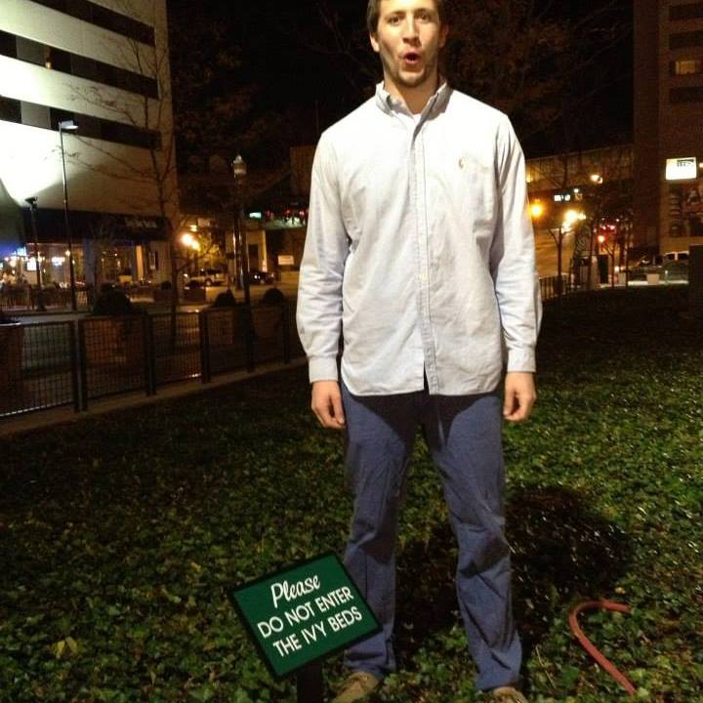
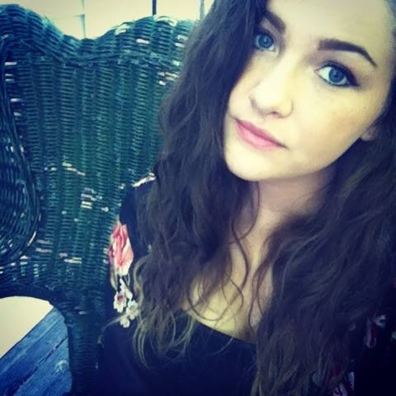
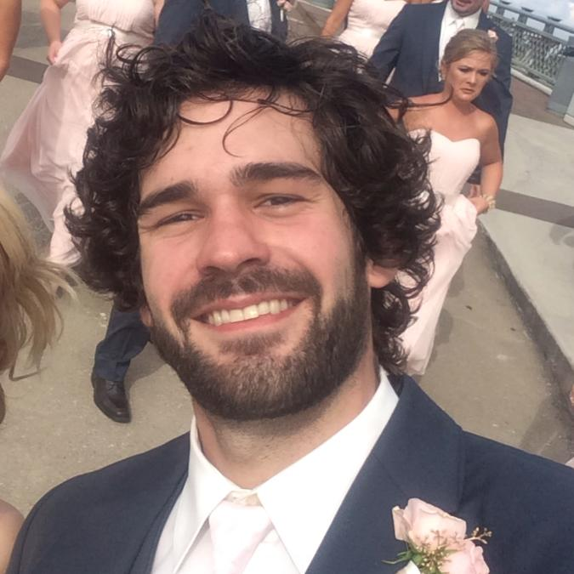
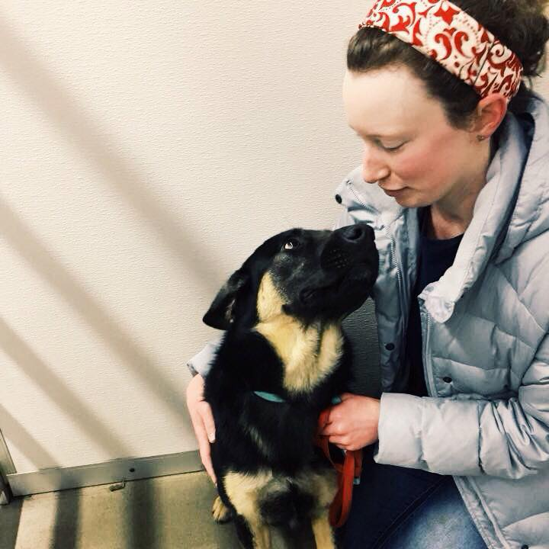
Participants
Nate Askins
Susan Breidenich
Evan Brown
Daniel Castro
Brad Chambers
Hunter Cullip
Steven Dossey
Sam Higgs
Drew Hillebrand
Seth Hulsey
Sadie Lack

Slide 3
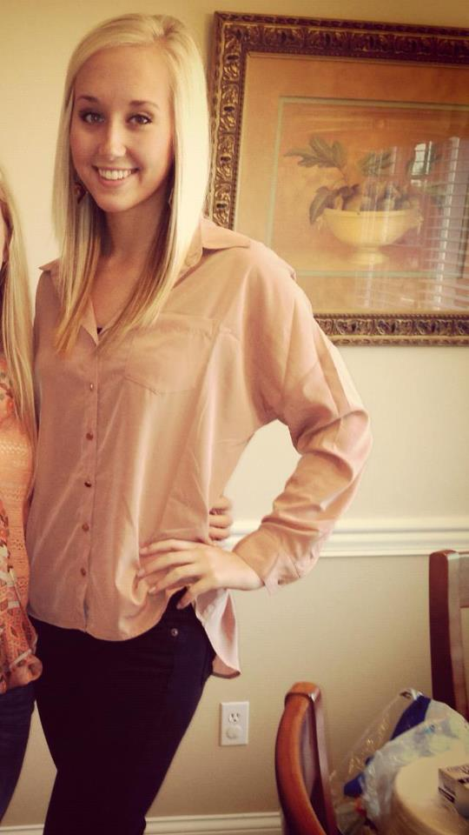
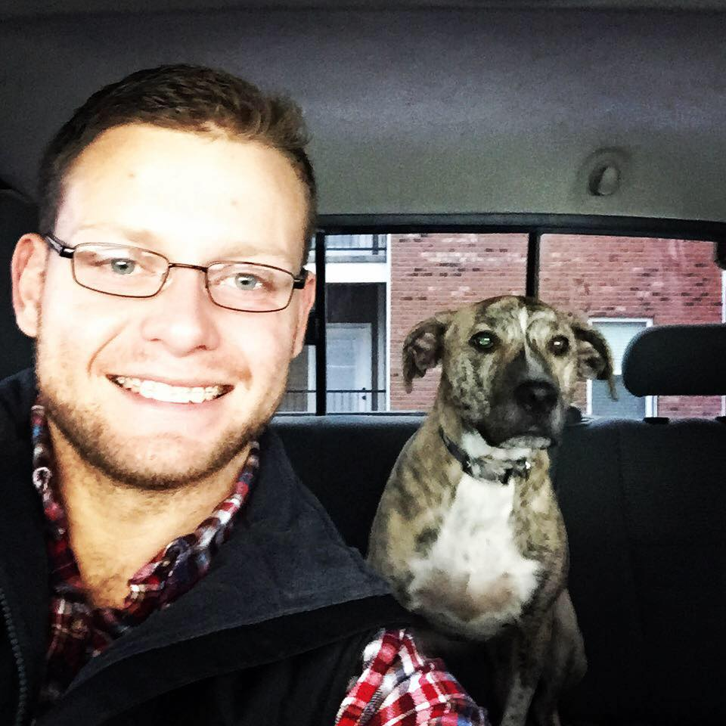
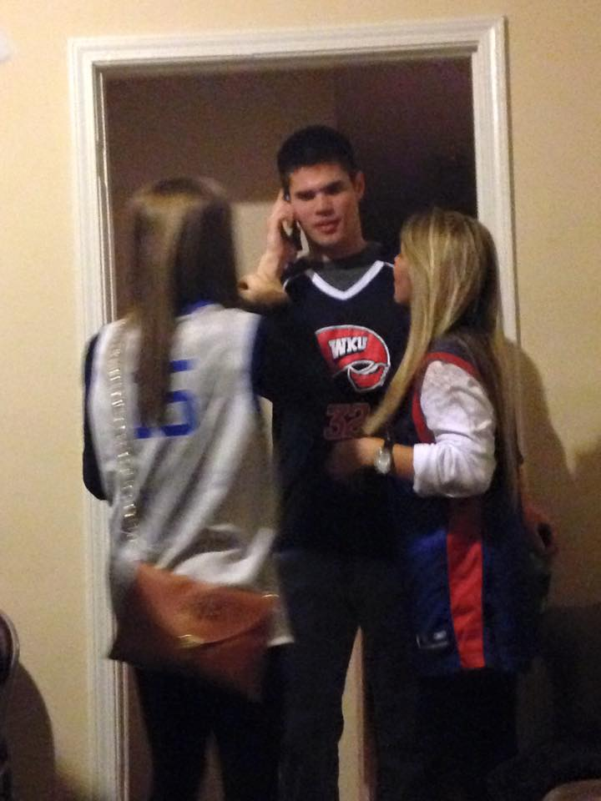
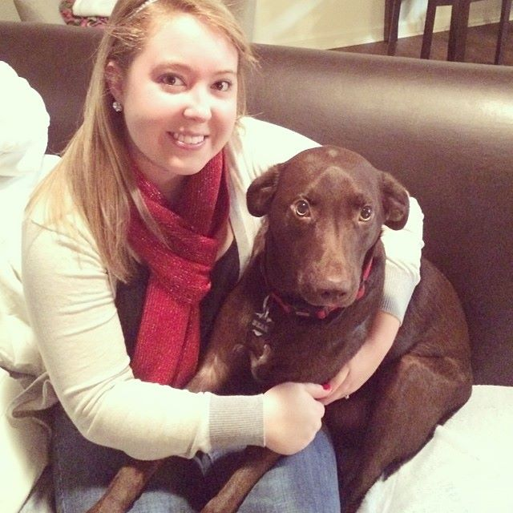
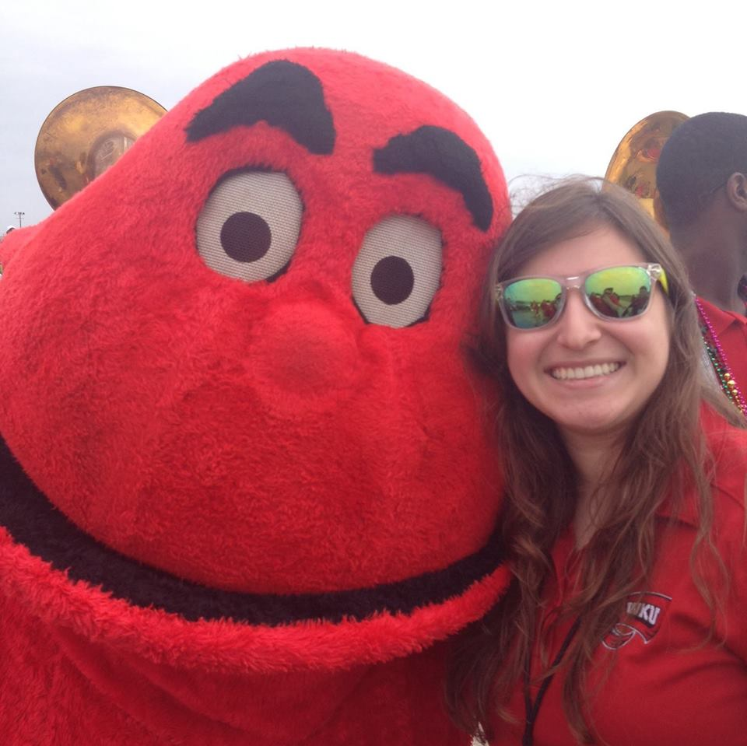
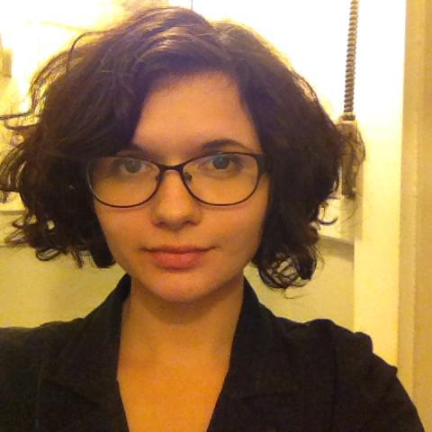
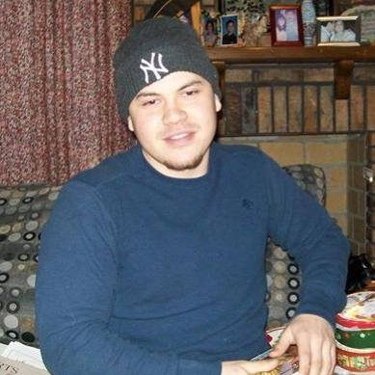
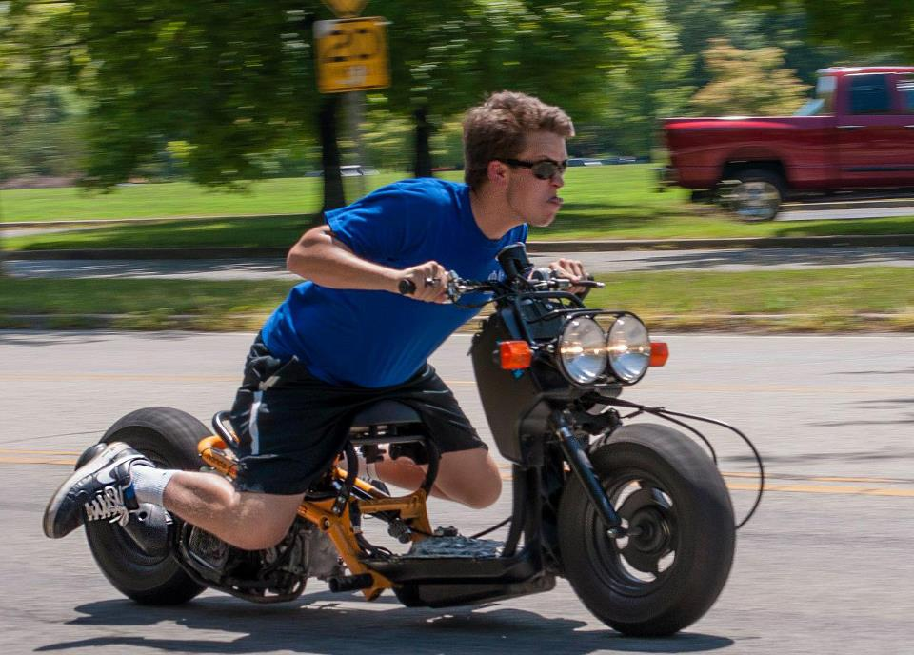
Participants
Nate Askins
Hayley Maciel
Susan Breidenich
Sky(ler) Manning
Evan Brown
Franklin Milam
Daniel Castro
Emily Oney
Brad Chambers
Mike Ozden
Hunter Cullip
Siid Price
Steven Dossey
Sarah Sejdic
Sam Higgs
Trinity Vannoy
Drew Hillebrand
Andrew Wall
Seth Hulsey
Rachel Wilkerson
Sadie Lack
Quinten Wright

Slide 4
Travel
United Airlines
Frequent Flier Programs
www.united.com
Aircraft
Nashville-DC EMB 145; DC-Amsterdam 767-300
Amsterdam - Houston 777 200; Houston – Nashville CRJ 700

Slide 5
Travel Wednesday, July 15
Nashville– Washington, DC UA 3400
1:10 p.m. – 3:56 p.m.
BE AT AIRPORT NO LATER THAN 10:30
Wait at benches across from United
HAVE YOUR PASSPORT ON YOU
Dr. Pruitt will check you in as a group
Washington, DC - Amsterdam UA 946
5:20 p.m. – 7:15 a.m. Thursday
The plane will leave without you
Customs and Immigration

Slide 6
Travel Thursday July 16
Arrive Amsterdam Schiphol Airport
DO NOT LEAVE YOUR BAGS IN CUSTOMS
Gather
Toilets
ATM
Snack
Receive transportation pass, train ticket
Train to Centraal Station

Slide 7
Travel Friday, August 7
Amsterdam – IAH UA 595
11:10 a.m. – 2:25 p.m.
Customs and Immigration
IAH – Nashville UA 5169
7:05 p.m. – 8:57 p.m.

Slide 8
Travel
Baggage
Check united.com
One checked bag
One carry on bag
One personal item
In flight
Personal video system
Meal
Snack

Slide 9
Travel
Seat Assignments
Done in bulk
Special requests
Left handed persons on left aisle, window?
Tall persons on aisle?
Someone you want to sit beside (or NOT sit beside)
May be able to change after ticketing
Return later difference in fare (+possible $300 fee if changes made later).

Slide 10
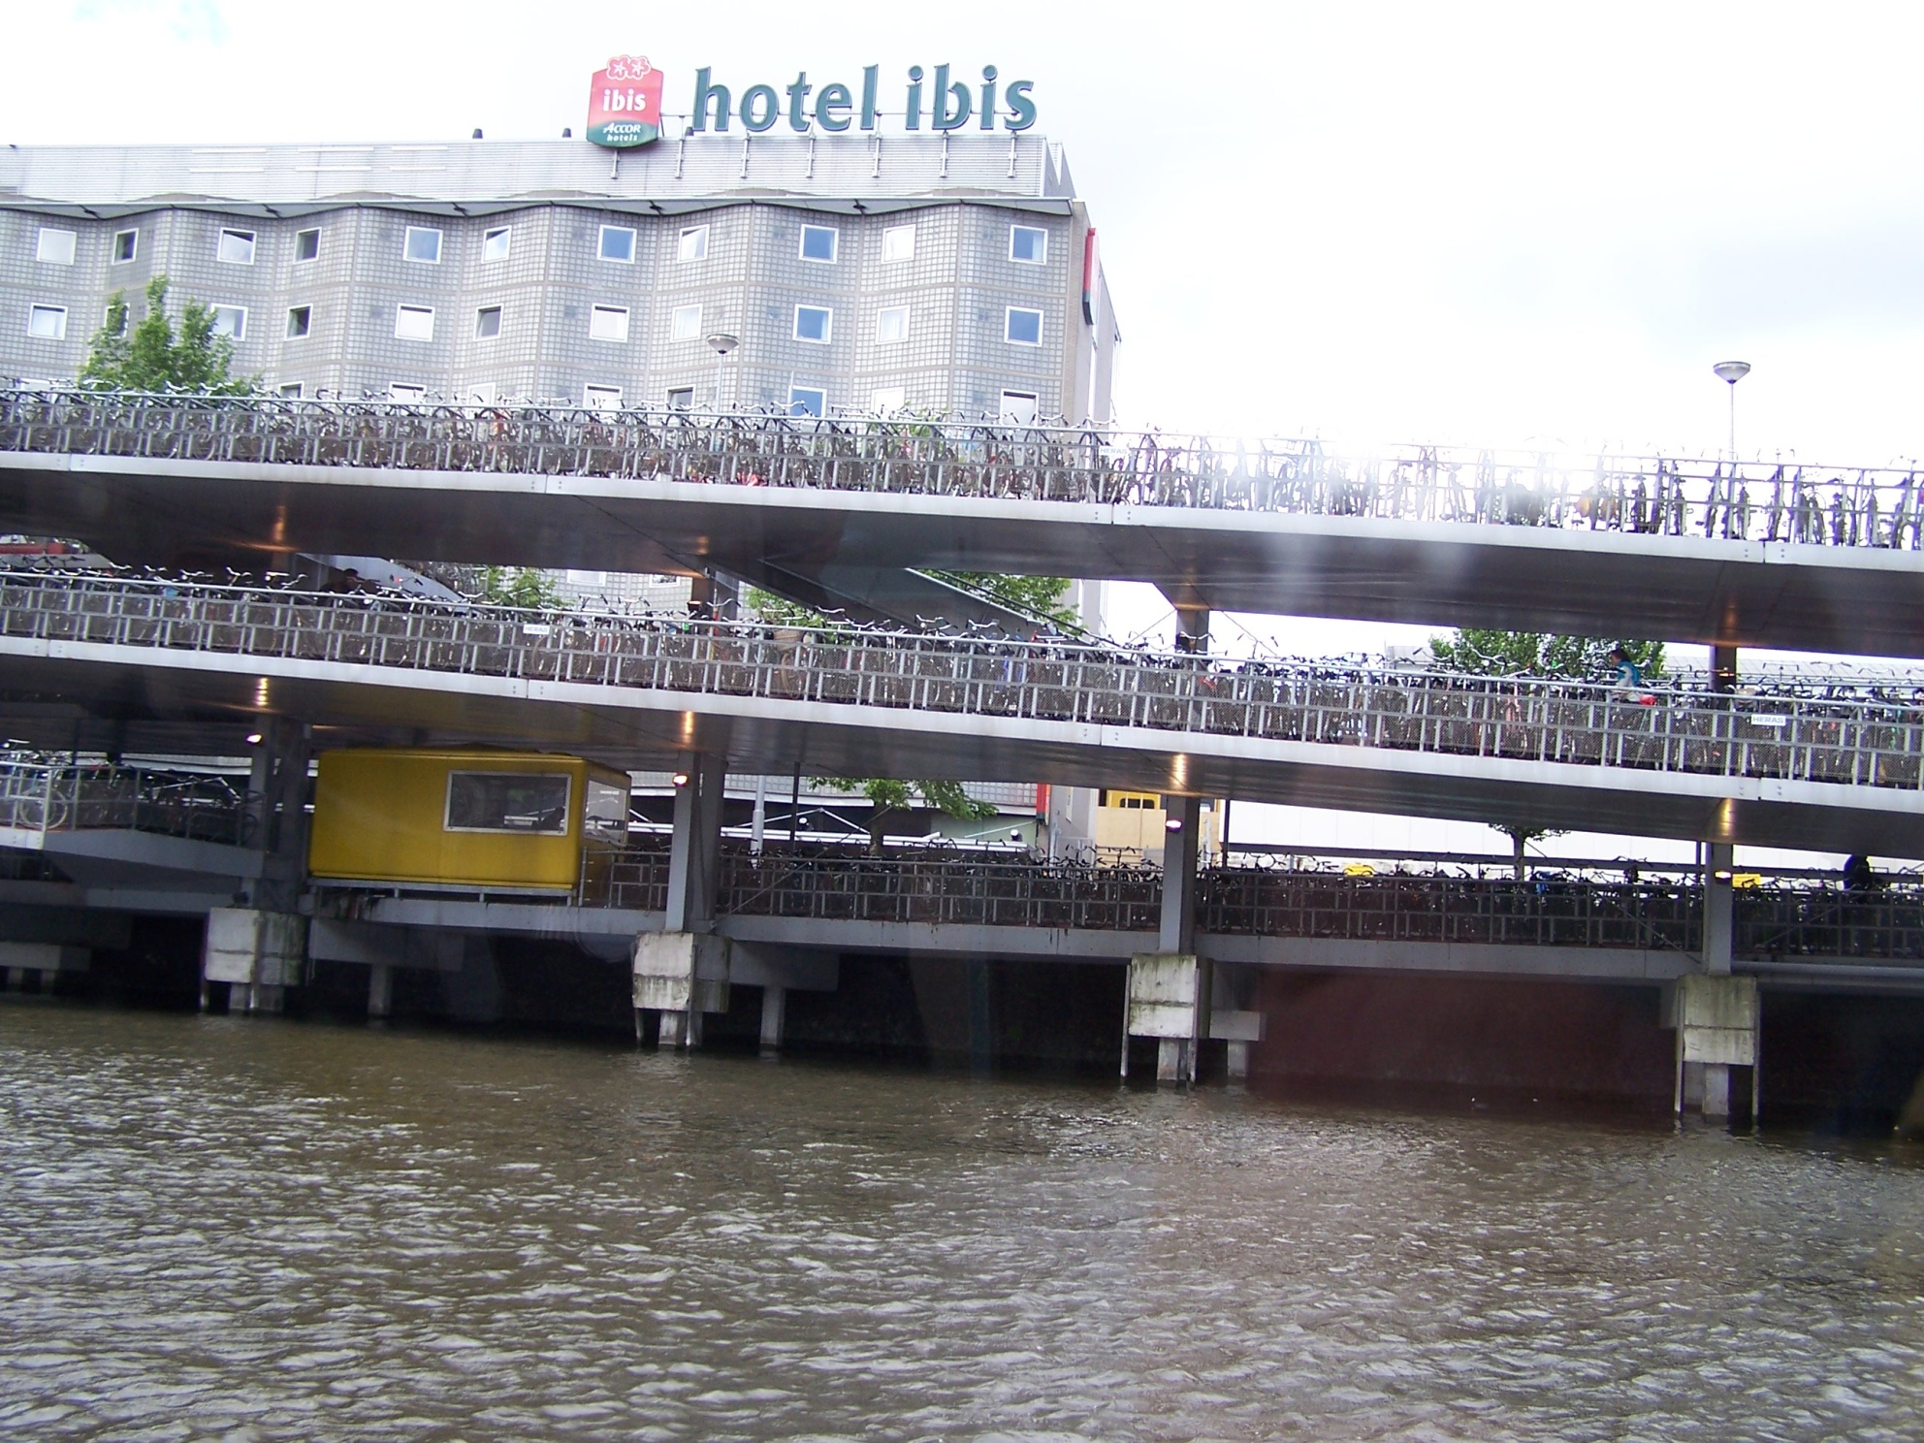

Slide 11
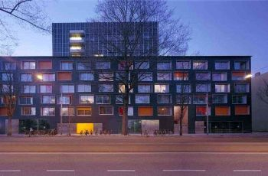
In Amsterdam Housing
Sarphatistraat
Location
2 per room
Shower and toilet
Kitchen
Wired Internet in the rooms
network card and a RJ 45 cable
You may want to bring a router or purchase one there

Slide 12
In Amsterdam Housing
Provided
Linens for bed
Sheets
Pillow (sort of)
Duvet and duvet cover
Keep clean

Slide 13
In Amsterdam Housing
Muidergracht 20
Location
2 per room
Shower and toilet shared with 3 rooms
Kitchen
WIFI in room

Slide 14
Laundry
Apartments have laundry facilities.
One per building
You provide the detergent and the fabric softener.
You wash, fold and put them away. Mother will not be there to do it for you.

Slide 15
Amsterdam
map

Slide 16
In Amsterdam Transportation
Transportation pass

Slide 17
Electricity
240 not 110
Converters (buy prior to trip)
Adapters (CAN buy there)
Hair dryers and flat irons often burn out
It may be advisable to purchase one there and share with your roommate

Slide 18
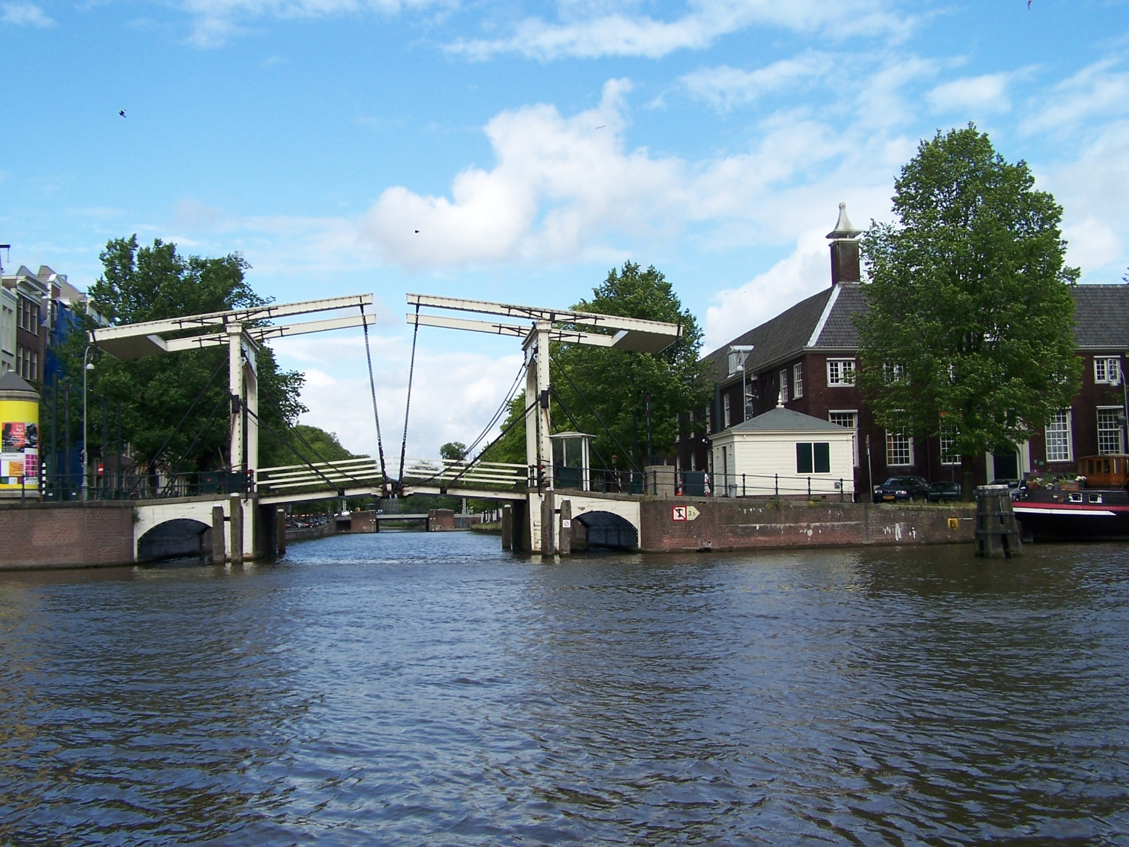

Slide 19
The Netherlands

Slide 20
Belgium

Slide 21
Weather
Average July high 71. Average low 53. Average precipitation 3”.

Slide 22
Class
We will meet in a classroom MWF from 10:00 until around 12:30
Other days we will have group outings.
Most afternoons will be free, but some may have scheduled activities.
Other than the first weekend, you are free from 12:30 Friday until class starts on Monday.

Slide 23
Clothes
Bring warm weather clothes
Bring cool weather clothes
Bring comfortable walking shoes
Bring leather dressy shoes (they dress to go out)
Professional (business casual) clothes (flower auction, EC)
Classroom dress be comfortable.
Going out clothes.

Slide 24
Toiletries
Coordinate with your roommate
Hair dryers (may want to buy there)
Hot irons (may want to buy there)
240 not 110
Takes hairdryer longer to heat if using a converter – often burn out.
Prescription drugs
Carry on in original container
Bring enough for the entire trip

Slide 25
Money
ATM is the cheapest way to get money
Traveler’s checks are a pain and are costly
Exchanging cash is costly
Contact your bank and credit card providers to let them know you will be traveling – ask for chip and pin
4-digit pin for ATM

Slide 26
Phones
You may buy a phone or a sim card there
We would like you to have a phone with you, preferably with a local number
US service is costly

Slide 27
Behavior
We expect students to participate in all program activities, assignments, and classes and to conduct themselves in an appropriate manner. Should your behavior be deemed disruptive to the program, the directors reserve the right to dismiss you from both the program and the housing for the program and arrange for your immediate return to the US without refund. Any additional costs associated with dismissal will be the responsibility of the student.

Slide 28
Behavior
Be on time.
Attend all functions.
Sober
Alert
Respect neighbors
Respect classmates

Slide 29
Behavior
You WILL be exposed to new customs
Dutch are generally private people
Dutch respect the right of others to make decisions

Slide 30
DRUGS
Street drugs are often adulterated (and potentially dangerous) or bunk.
Marijuana in the Netherlands is often significantly more potent than strains that are found in the US, and this higher potency may cause users to experience negative effects.
Significant penalties are associated with the use, purchase, and possession of drugs other than cannabis.

Slide 31
Culture and Customs
Language
Learn some Dutch phrases
Most people understand English
Be careful what you say

Slide 32
Culture and Customs
Shopping
VAT (value added tax) is included in the price of goods
Groceries and other stores MAY charge you for bags.
You may want to pack a reusable shopping bag

Slide 33
Culture and Customs
Dining
Dining is an experience in Europe
Servers generally will not check with your table and will not bring your bill until you ask
NO FREE REFILLS
Water and ketchup may cost
Soft drinks may cost more than beer/wine
KFC does not serve mashed potatoes

Slide 34
What We Need From You
Complete all forms with SAGL
Copies of your passport (first page) to SAGL
Attend SAGL Faculty Led orientation
Tuesday, April 21, 2:30-4:00
Wednesday, April 22, 4:30-6:00
Thursday, April 23rd, 4:00-5:30 PM

Slide 35
What We Need From You
CHECK EMAIL REGULARLY.
LOOK FOR EMAIL MESSAGES FROM PRUITT, MYERS, AND SAGL
Information will be posted on Blackboard

Slide 36
What We Need From You
e-mail any special requests to Myers
Seating
Roommates
Meals
Change in schedule
Summer information
e-mail
Phone
Cell phone (in the car on your way to the airport)

