Slide 1
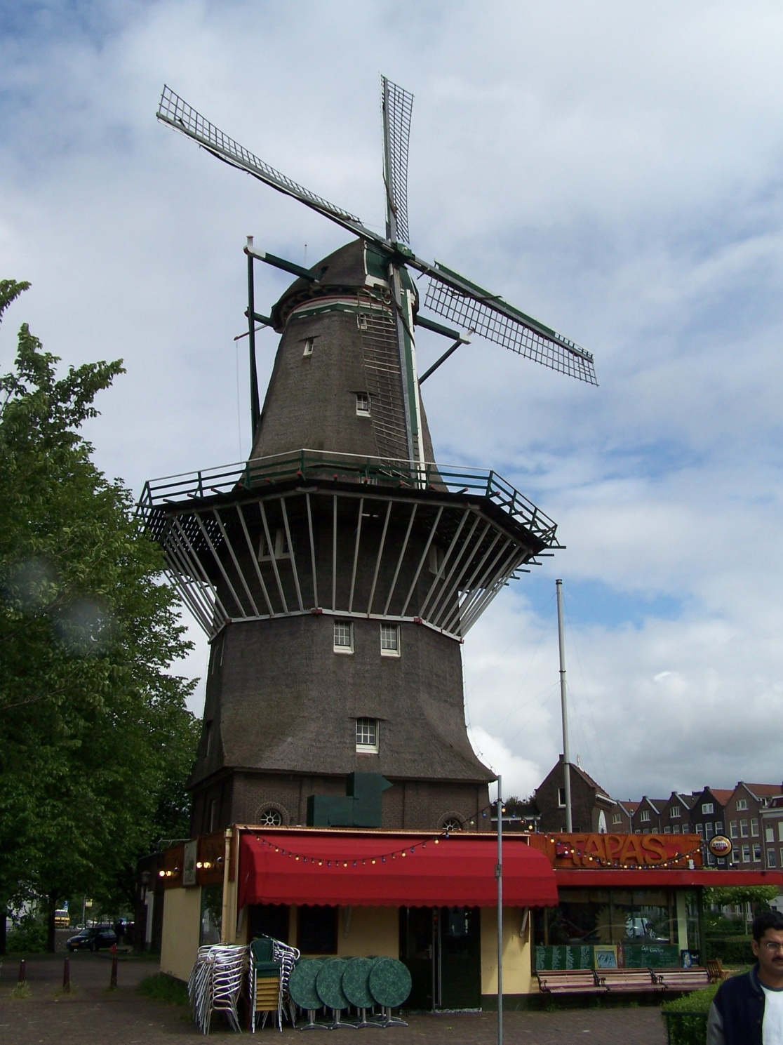
Amsterdam 2013
Orientation 1

Slide 2
Participants
Melissa Ackerman
Erin Asher
Louis Bunch
Michael Carpenter
Josh Carter
Christina Casas
Benjamin Conniff
Paige Harrison
Taylor Helton
Shannon Hopper
Michael Keller
Kristina Mason
Alyssa Page
Blake Sarmiento
Tyler Shields
Donald Snider
Paul Steenbergen
Collin Steiner
Justin Thurman
William Young
Mei Zhou

Slide 3
Travel
United Airlines
Frequent Flier Programs
www.united.com

Slide 4
Travel Wednesday, July 10
Nashville– Washington, DC UA 3400
1:10 p.m. – 3:56 p.m.
Washington, DC - Amsterdam UA 946
5:25 p.m. – 7:15 a.m. Thursday

Slide 5
United

Slide 6
Travel Friday, August 2
Amsterdam – DC UA 947
11:15 a.m. – 1:55 p.m.
DC - Nashville
4:50 p.m. – 5:37 p.m.

Slide 7
Travel
Seat Assignments
Done in bulk
Special requests
Left handed persons on left aisle, window?
Tall persons on aisle?
Someone you want to sit beside (or NOT sit beside)
Can change on line after ticketing
Return later (up until time of ticketing, difference in fare (+possible $250 fee)).

Slide 8
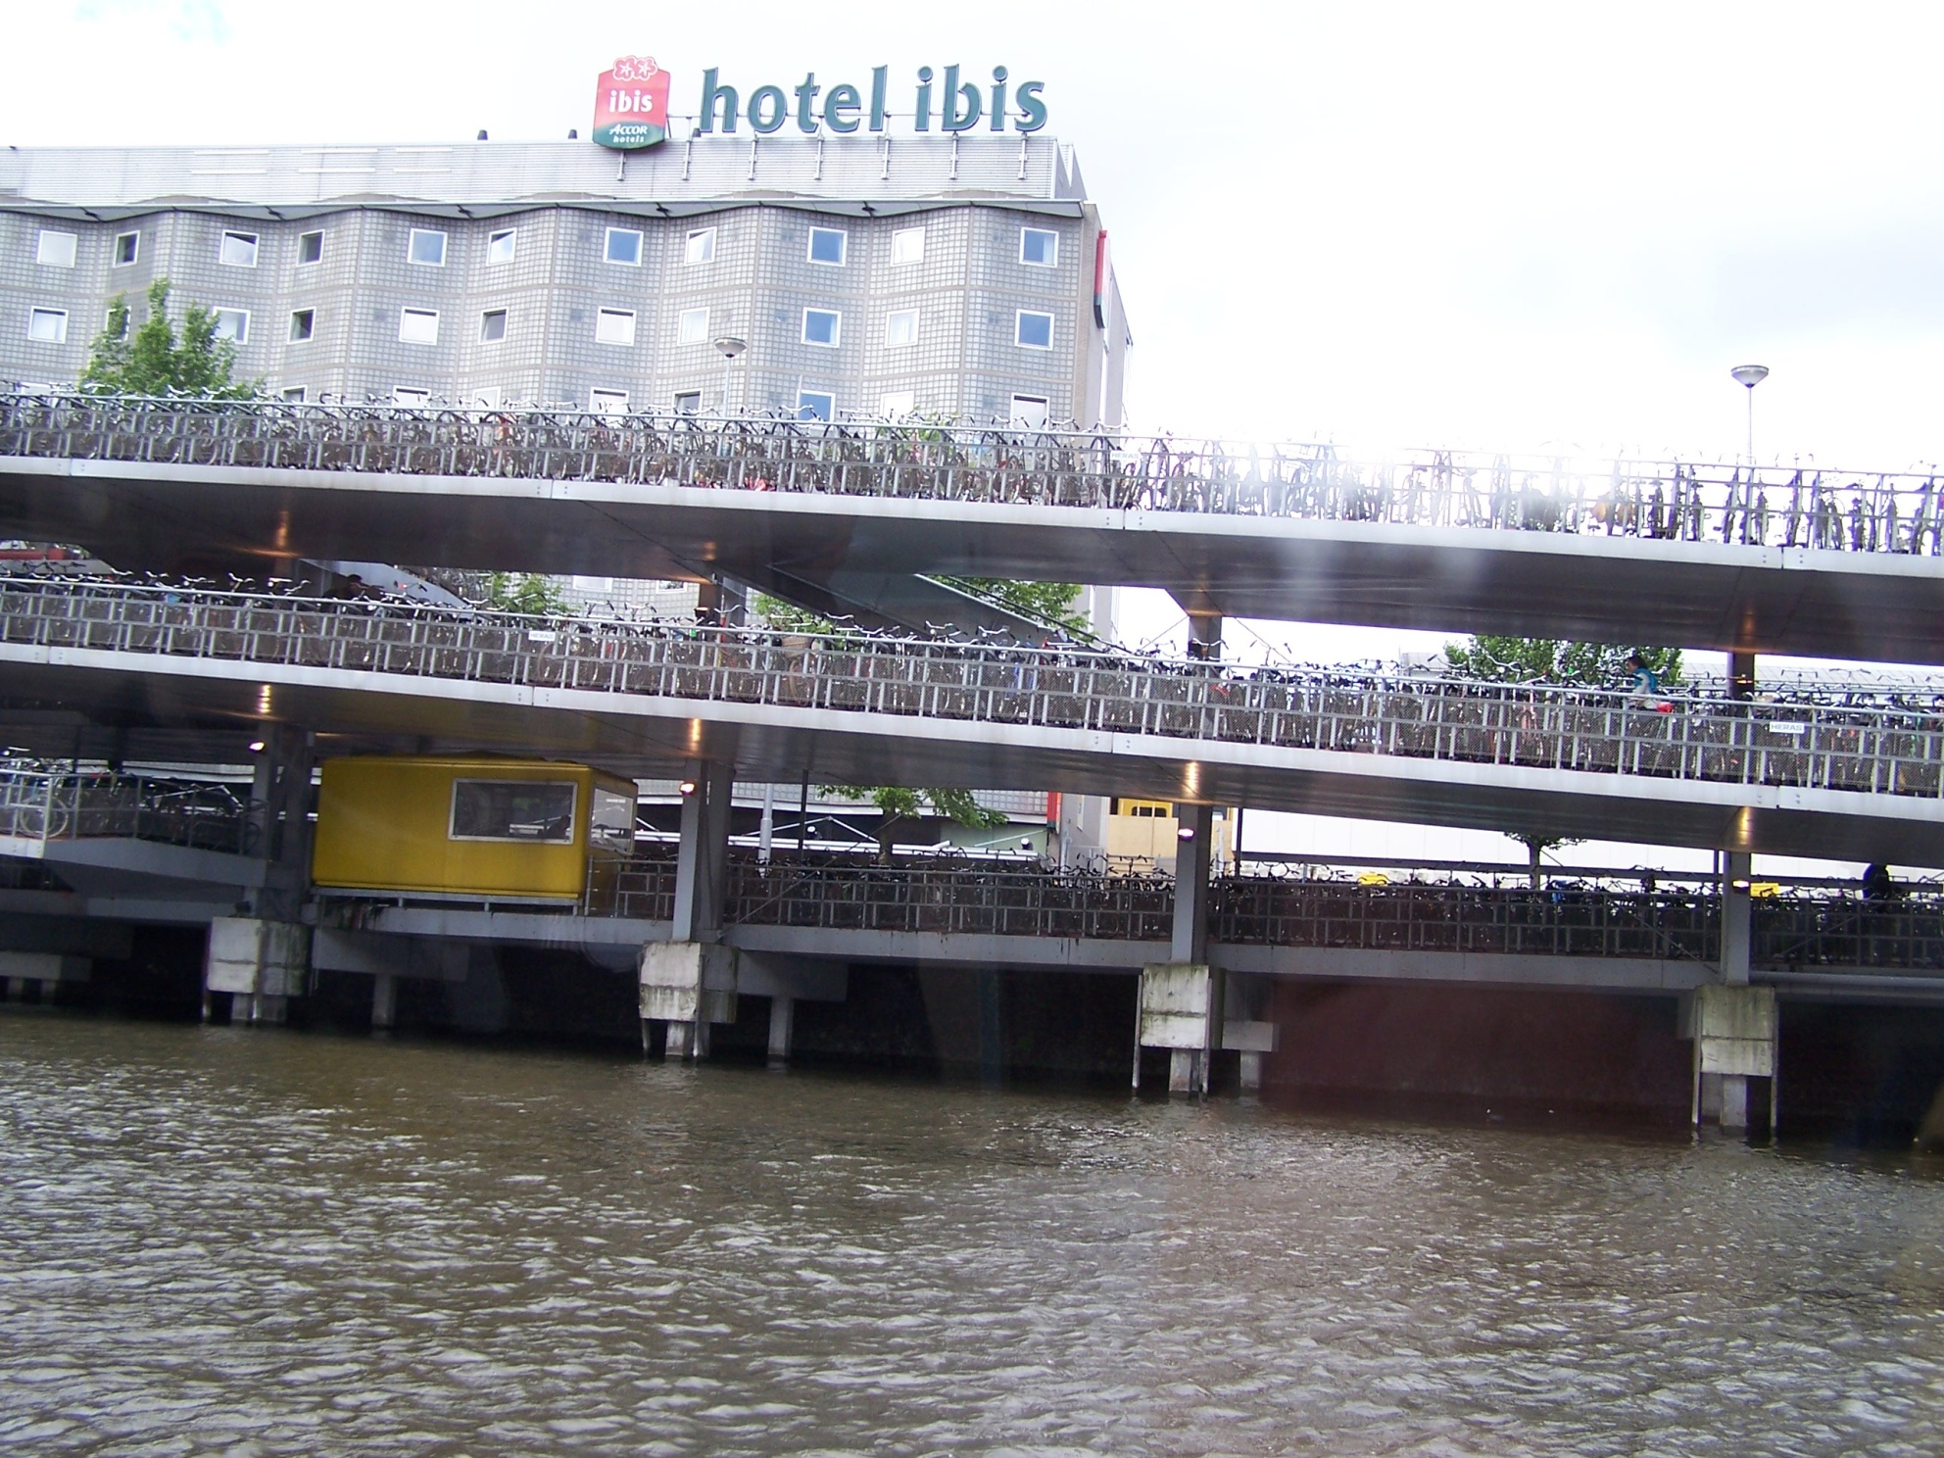

Slide 9
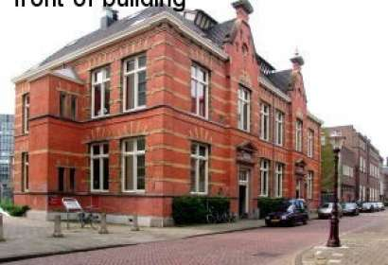
In Amsterdam Housing
Muidergracht 20
Location
2 per room
Shower and toilet shared with 3 rooms
Kitchen
WIFI in room

Slide 10
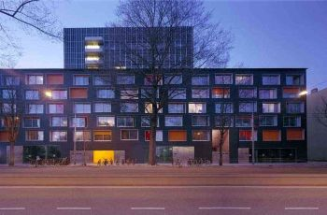
In Amsterdam Housing
Sarphatistraat
Location
2 per room
Shower and toilet
Kitchen
Internet in the rooms
network card and a RJ 45 cable

Slide 11
Laundry
Apartments have laundry facilities. You provide the detergent and the fabric softener. You fold and put them away.

Slide 12
Amsterdam
map

Slide 13
In Amsterdam Transportation
Transportation pass

Slide 14
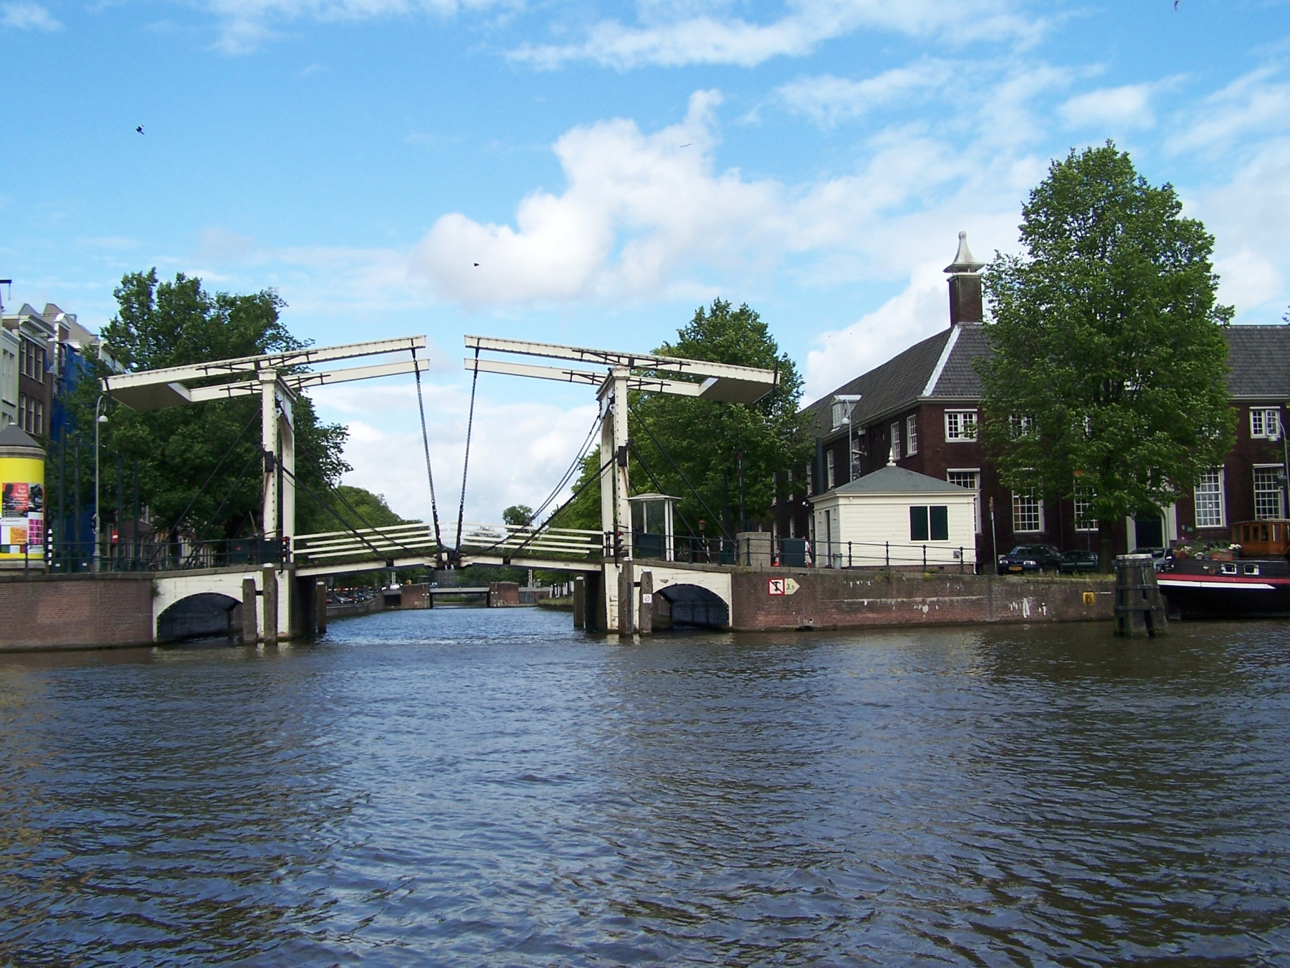

Slide 15
The Netherlands

Slide 17
Weather
Bring warm weather clothes
Bring cool weather clothes
Bring collapsible umbrella
Average July high 71. Average low 53. Average precipitation 3”.

Slide 18
Clothes
Bring warm weather clothes
Bring cool weather clothes
Bring comfortable walking shoes
Bring leather dressy shoes (they dress to go out)
Dress/skirt for the ladies and slacks (not jeans) and collared shirt for men (flower auction, EC)
Classroom dress be comfortable.
Going out clothes – ask Andy.

Slide 19
Money
ATM is the cheapest way to get money
Traveler’s checks are a pain and is costly
Exchanging cash is costly
Contact your bank and let them know you will be traveling
4-digit pin

Slide 20
Phones
SAGL web site lists options for securing a phone before departure
You may buy a phone or a sim card there
We would like you to have a phone with you, preferably with a local number
US service is costly

Slide 21
What We Need From You
Complete all forms with SAGL
Copies of your passport (first page) to SAGL
Attend SAGL Faculty Led orientation
04/18/2013 6:30-7:30 PM, Gary Ransdell Hall Auditorium (GRH 1074)
04/23/2013 4:30-5:30 PM, Gary Ransdell Hall Auditorium (GRH 1074)
CHECK EMAIL REGULARLY. LOOK FOR EMAIL MESSAGES FROM PRUITT, MYERS, AND SAGL

Slide 22
What We Need From You
e-mail any special requests to me
Seating
Roommates
Meals
Change in schedule
Summer information
e-mail
Phone
Cell phone (in the car on your way to the airport)

Slide 24
Meeting in April
April 16 (Tuesday)

Slide 25
Cost?

