Slide 1
Ethics of Markets

Slide 2
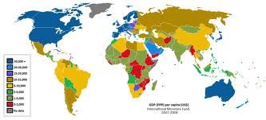
Market Ethics: Where Markets Are Widely
Protected and Used, Living Standards Are High
for All Income Levels

Slide 3
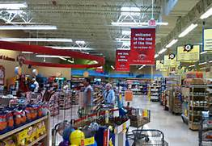
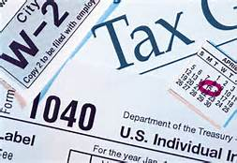
Market Ethics: Voluntary Exchange v. Force

Slide 4
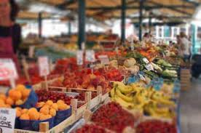
Market Ethics: Markets Allow Expression of Diverse Preferences

Slide 5
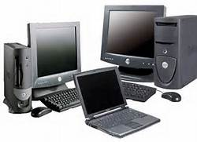
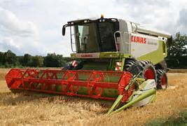
Market Ethics: Dynamic Adjustments

Slide 6
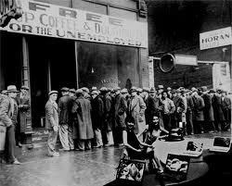
Market Ethics: Markets Are Not Perfect
Fraud, Greed, Luck, Crashes …
Other “Systems” Not Immune

