Slide 1
Financial & Economic Situation
Where We Have Been
Where We Are
Where We Are Going

Slide 2
Key Questions
How did the current econ/financial situation arise?
  What are causes and what are effects?
    What are the unfolding of events v. root causes?
  What are the roles of the public sector and private sector?
  What impact of financial innovation, MTM accounting, foreign investment, …?
How does the current financial/econ situation stack up against past episodes?
What indications of where we may be headed are given by past episodes?

Slide 3

Financial/Econ Crisis in a Picture

Slide 4
U.S. Debt Growth

Slide 5
European Data

Slide 6
Debt Growth by Sector

Slide 7
Magnitude of Recent Debt Growth?

Slide 8


Income & Debt Constraints
Infinite Horizon Economy Budget Constraint:
Income + Debt = Debt Service + Consumption
No Ponzi Scheme (Transversality) Constraint:
PV of debt converges to zero
Income (not debt) funds consumption over long run

Slide 9
How Much is Too Much?
Debt-Income Ratios in Simulations

Slide 10
Causes of Debt/GDP Expansion?
Cheap Credit

Slide 11
Cheap Credit: Fed’s Role?
Monetary Aggregates

Slide 12
Inflation Rates From 1982

Slide 13
Inflation Statistics:
1982-2001, 1990-97, 1998-05, 2002-05

Slide 14
Cheap Credit: Public Sector Supply-Side

Slide 15
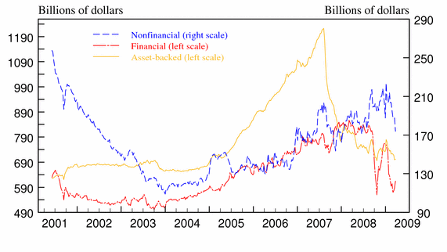
Cheap Credit: Expansion/Term Reduction in Markets (e.g. Commercial Paper)

Slide 16
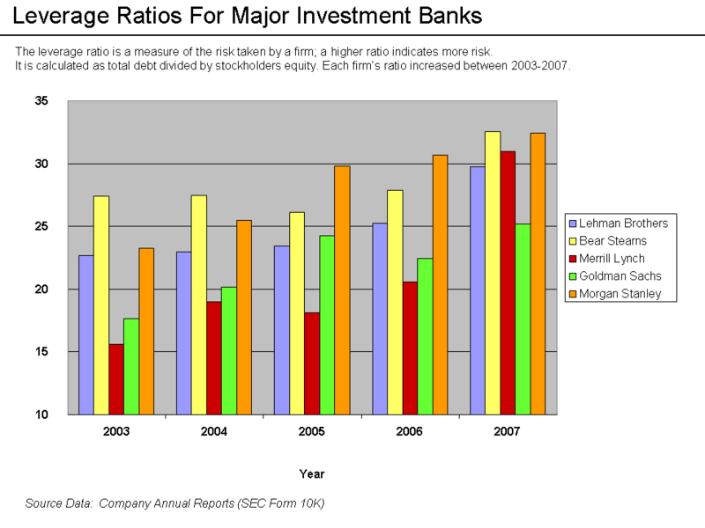
Cheap Credit: Increasing Leverage

Slide 17
Cheap Credit: Innovations
Risk-Influencing Innovations
  Securitization, e.g. CDOs – risk pooling
  Derivatives (“Insurance”), e.g. CDS – risk transfer
Key Issues/Questions:
  Aggregate Risk not influenced by pooling/transfer
  Miscalculation of expected flows
    Probability of Event x Size of Event
  How big of an influence on credit growth/crisis?

Slide 18
Securitization & Credit Growth
Global CDO New Issuance (in billions $)
U.S. Mortgage market increased by $7T from 2000-2008
U.S. & Euro Area Debt increased by $35T from 2000-2008

Slide 19
Credit Market “Insurance”
Reported Values of CDS Growth Enormous
    “Notional Values” = $2T (2003), $34T (2007), $60T (2008)
Key Questions:
  What are the real notional values after “netting”?
  What are the cash flow implications of these values?
    Actual v. reported notional values & cash flow implications example:
        Lehman Failure: estimated $400B in CDS protection
        Bond “Recovery Rate” only 8% -- implied CDS liability = $380B
        Roubini’s Group (RGE) Estimates Cash Flow impact of $270B after netting
        October 21, 2008: $6B in actual cash settlements (1.5%)
        Note: Expected value of “protection” in Lehman Model = 2% of notional value
In the end, not clear that the cash flow implications of these innovations have been that great

Slide 20
Foreign Capital & U.S. Debt

Slide 21
Role of Foreign Capital?

Slide 22
Role of Marked-to-Market Accounting?
How big of an effect is possible from MTM pricing of banks?
See SEC Dec. 2008 Study www.sec.gov/news/studies/2008/marktomarket123008.pdf
  31% of bank assets MTM
    22% of these impact income statement
    Part of this amount in Treasuries
Differences in MTM and “amortized cost”
  If 20% difference, then 4.4% impact on income
  Currently, using “amortized cost” method
    Citi assets increase by apx. $3B (out of $1.2T)
    BoA assets increase by apx. $9B (out of $1.4T)

Slide 23
Where Are We Now?
U.S. Stock Crashes Since 1907

Slide 24
Stock Crash Similarities
(16 months in)

Slide 25
How Much Like the 1930s?

Slide 26
Stock Crashes & Real Effects

Slide 27
GDP What Ifs (From 2007 peak of $11.5T GDP (in 2000$) and U of 4.7%

